Slide 1
MULTIMODAL INFORMATION RETRIEVAL AND UNCERTAINTY MANAGEMENT IN OPEN-WORLD ENVIRONMENT
Examining Committee:
Bharat Bhargava (Advisor)
Chunyi Peng
Vaneet Aggarwal
Jianguo Wang
Xavier Tricoche
KMA Solaiman
Ph.D. Dissertation Defense
July 14, 2023
Notes:
MULTIMODAL DATA MANAGEMENT IN OPEN-WORLD ENVIRONMENT AND UNCERTAINTY MANAGEMENT IN AI SYSTEMS

Slide 2





Collaborations and Acknowledgements
I am very thankful to Michael Stonebraker from MIT for being a mentor during REALM.
Thanks to MIT team and Michael Cafarella from University of Michigan during our work in SKOD.
Jim MacDonald from NGC for leading REALM and always helping us with innovative research directions
Thanks to Sgt. Greene from West Lafayette Police Department for providing data, discussing use cases, and helping to analyze the problem domain such as missing person, school shooting, etc.
Novelty Working Group with Mayank Kejriwal, Terry Boult, Josh AlSpector, Eric Kildebeck, Pat Langley, Katarina Doctor.
Thanks to my colleagues Alina, Palash, Servio, Denis and others from Purdue, and Tao, Aaron, Zack from MIT for our collaborations on building the prototypes.
Thanks to my colleagues Shafkat and Ruy for our collaborations on open-world novelties to conduct further experiments.

Slide 3
Publications and Artifacts
K. Solaiman et al. Feature Centric Multi-modal Information Retrieval in Open World Environment (FemmIR), SIGMOD 2023 (positive reviews) (To be submitted in VLDB 2024).
S. Islam and K. Solaiman**, R. Oliveira, B. Bhargava, Domain Complexity Estimation for Distributed AI Systems in Open-World Perception Domain, Artificial Intelligence (Open-World AI), July 2023. ** Co-first authors.
K. Solaiman, T. Sun, A. Nesen, B. Bhargava and M. Stonebraker, "Applying Machine Learning and Data Fusion to the Missing Person Problem" in IEEE Computer, vol. 55, no. 06, pp. 40-55, 2022.
K. Solaiman and B. Bhargava, Open-Learning Framework for Multi-modal Information Retrieval with Weakly Supervised Joint Embedding, AAAI Spring Symposium on Designing Artificial Intelligence for Open Worlds, March 2022.
K. Solaiman and B. Bhargava, Measurement of Novelty Difficulty in Monopoly, AAAI Spring Symposium on Designing Artificial Intelligence for Open Worlds, March 2022.
A. Nesen, K. Solaiman and B. Bhargava, Dataset Augmentation with Generated Novelties, IEEE TransAI, 2021.
M. Stonebraker, B. Bhargava, M. Cafarella ,Z. Collins, A. Sipser, T. Sun, J. McClellan, A. Nesen, K. Solaiman, G. Mani, K. Kochpatcharin and P. Angin, J. MacDonald, Surveillance Video Querying With A Human-in-the-Loop, In Human-In-the-Loop Data Analytics (HILDA 2020) with SIGMOD conference, 2020.
S. Palacios and K. Solaiman** et al. SKOD: A Framework for Situational Knowledge on Demand. In Polystores and other Systems for Heterogeneous Data (Poly 2019), at VLDB 2019, LA, California, August 2019. ** Co-first authors.
Artifacts
Find-Them, (https://youtu.be/hJ_jtLQUIXo), IEEE Computer 2022.
SurvQ Extension, https://youtu.be/z9iJyGrFBtg, 2023.
SurvQ, https://github.com/skod-ng/, SIGMOD 2020.
SurvQ Demo (https://youtu.be/qPO73mGXqds), SIGMOD 2020.
SKOD, https://github.com/purdue-gask, VLDB 2019.
SKOD Demo (https://youtu.be/5TqWKzy5SqI), VLDB 2019.
Notes:
SurvQ Extension with new video features, search history, and personalized accounts,
S. Palacios and K. Solaiman** et al. SKOD: A Framework for Situational Knowledge on Demand. In Polystores and other Systems for Heterogeneous Data (Poly 2019), at VLDB 2019, LA, California, August 2019. ** Co-first authors.

Slide 4
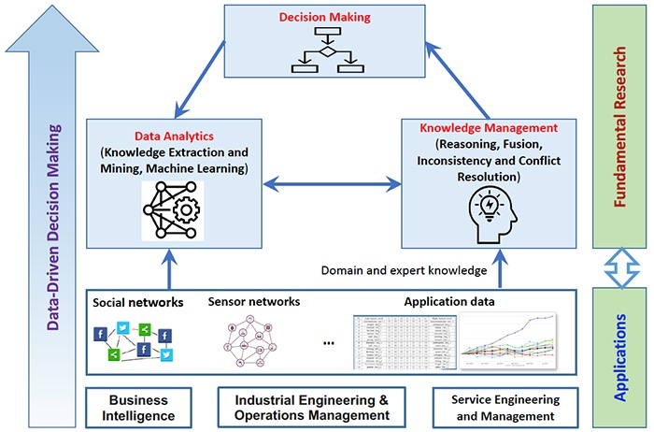


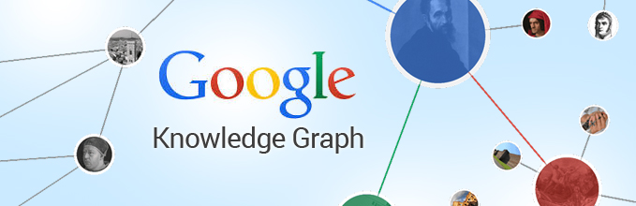
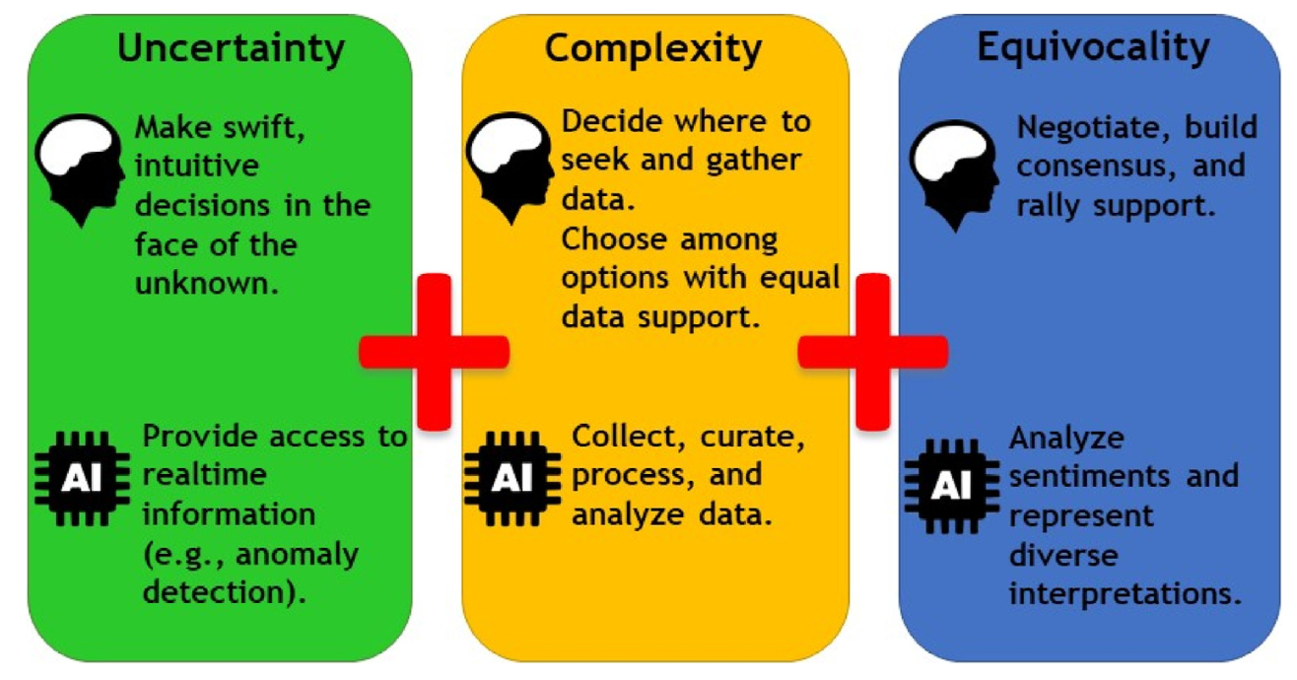




Background and Motivation
Recommender Systems
Utilize all available, relevant information obtained from multiple sources to
autonomously and continually provide decision making information that is specific to application needs, while being able to adapt to uncertainties in a open-world environment
Multimodal data
* https://www.jaist.ac.jp/english/laboratory/cci/huynh.html
** Koufteros, Vonderembse, & Jayaram, 2005
Notes:
Plenty of recommender systems, but all single modality, either image, or movies(netflix), or just metadata search (google), audio (Spotify)
Need to consider the content
Google finds similar entities with similar charactersics, given the search keyword is of entity type. But can one mention the context, for example, they want presidents, or Harvard alumni’s
https://www.jaist.ac.jp/english/laboratory/cci/huynh.html
It is important to note that the decision-making pro- cess often involves all three characteristics discussed–—uncertainty, complexity, and equivocality (Koufteros, Vonderembse, & Jayaram, 2005)–—and these characteristics should not be understood as mutually exclusive.

Slide 5
Challenges
Extracting decision-making information from multimodal data requires finding common representation for source and context, fulfilling current needs from incomplete data, and predicting future needs.
Solution:
Exploiting entity-centric higher-level semantic concepts, RESTful indexing, relational queries, and distributed stream-processing for building multimodal query engines
Exploiting inherent semantic and stylistic properties for task-specific features
Exploiting encapsulation properties of view-based data integration to gain scalability

Slide 6
Challenges
Knowledge management requires data integration and inconsistency resolution. Data integration approaches need to adapt to exact and approximate matches, novel data sources, and continual learning. This often faces the issue of lack of annotation data.
Solution:
Find novel sources of supervision other than relevance labels
Exploiting representation learning to capture the interconnected nature of semantic features
Multimodal information retrieval, collaborative learning, or feature extraction models with multimodal data assumes closed-world fixed models and needs re-learning.
Solution:
Characterize, detect, and tackle novelties in dynamic data-driven applications, datasets, and in agent-based systems, such as in planning domains

Slide 7
Contributions
Scalable, real-time, feature-centric Situational Knowledge extraction and dissemination framework with a multi-modal relational knowledge base that can fulfill current and future data needs from incomplete and disaggregate data sources
A novel text attribute detection model using language representation models and syntactic properties
A Video Querying System with human-in-the-loop, Find-Them, and two novel MMIR datasets
A View-based Data Integration using relational structure of RDBMS and SQL Queries
Flexible, scalable, representation-invariant learning models for data integration, relevance-ranking, and similarity matching
Coordinated representation learning with graph matching and a novel distance metric for data objects
Relevance learning using weak supervision
Novelty Characterization, Detection, and Adaption in Multimodal Information Retrieval, distributed AI systems, and in planning domains
A novel intrinsic complexity metric for distributed AI applications in perception domains

Slide 8
Contributions
This work’s contribution
Part I
Deal with Challenges of Multimodal Information Extraction in Open-world
Part II
Understand Uncertainties in Open-world
Seek to move forward Data-Driven Decision Making in real-word applications

Slide 9
Contributions
This work’s contribution
Part I
Deal with Challenges of Multimodal Information Extraction in Open-world
Part II
Understand Uncertainties in Open-world
Seek to move forward Data-Driven Decision Making in real-word applications

Slide 10
Contribution #1: Situational Knowledge Extraction on Demand
Use Case 1: Video Querying With A Human-in-the-Loop (SurvQ)
Use Case 2: Applying ML and Data Fusion to the Missing Person Problem (Find-Them)

Slide 11
Problem Statement and Motivation
Multimodal Information Retrieval (MMIR)
Fails to process streaming data as it ingests
Limited to modality-specific transformers due to low-level feature extraction
Do not consider context information in relevance matching
User preference or mission need is not considered, and is not dynamic
Difference between MMIR benchmark datasets and real-world datasets
Noisy, lacks relevance labels, heterogenous
Use cases: Video Feed Querying and Missing Person Search
Involve manually-performed investigations of large amount of multimodal data, especially video data, for a specific mission need
Determine relevant information from heterogeneous and multimodal data, both at-rest and streaming, either complete or incomplete, with scalability to large amounts of data and based on mission needs and user provided context.
Notes:
Utilize all available, relevant information obtained from multiple sources to autonomously and continually provide decision making information
Situational Knowledge needs to process both data-at-rest and heterogenous data
Data needs to be connected and data delivery must be on-demand for sensitive use cases
Has to scale to petabytes of data
Privacy issues

Slide 12
Related Works
Specific domains i.e., sentiment analysis, disaster, healthcare, robotics perform multi-modal data fusion for situational knowledge [1-4]
Often structured or just textual data
Does not allow user to mention information need
Not generalizable across applications
Visual QA, Missing person search [5-6, 19-20]
Limited to visual modality, and only textual augmentation
Query cannot be made with image or video data example
Does not search from streaming data
Query-driven approaches for knowledge bases [10-14]
Text data driven knowledge base built by queries [10]
Inconsistency and missing info [11]
Probabilistic methods need training data, fuzzy matching, text and structured data
Triggers used to deliver matching data [8-9], but rules are fixed
S. Poria, et al, “Fusing audio, visual and textual clues for sentiment analysis from multimodal content,” Neurocomputer, vol. 174, no. PA, pp. 50–59, Jan. 2016
Foresti, G.L et al: Situational awareness in smart environments: socio-mobile and sensor data fusion for emergency response to disasters. J. Ambient Intelligence and Humanized Computing 6(2), 239–257 (2015).
Meditskos, G. et al: Description logics and rules for multimodal situational awareness in healthcare. In: MMM (1). Lecture Notes in Computer Science, vol. 10132, pp. 714–725. Springer (2017)
Adjali, O et al: Multimodal fusion, fission and virtual reality simulation for an ambient robotic intelligence. In:ANT/SEIT. Procedia Computer Science, vol. 52, pp. 218–225. Elsevier (2015)
Y. Zhu et al, “Knowledge acquisition for visual question answering via iterative querying,” in CVPR, IEEE Computer Society, 2017, pp. 6146–6155.
Q. Wu et al, “Ask me anything: Free-form visual question answering based on knowledge from external sources,” in 2016 IEEE Conference on Computer Vision and Pattern Recognition, CVPR 2016, Las Vegas, NV, USA, June 27-30, 2016
Kang, D., Bailis, P., Zaharia, M.: Blazeit: Fast exploratory video queries using neural networks. CoRRabs/1805.01046(2018).
M. L. Itria, A. Daidone, and A. Ceccarelli, “A complex event processing approach for crisis-management systems,” CoRR, vol. abs/1404.7551, 2014.
G. Cugola and A. Margara, “Processing flows of information: From data stream to complex event processing,” ACM Comput. Surv., vol. 44, no. 3, 15:1–15:62, 2012.
D. B. Nguyen et al, “Query-driven on-the-fly knowledge base construction,” Proc. VLDB Endow., vol. 11, no. 1, pp. 66– 79, Sep. 2017
M. Bienvenu et al, “Query-driven repairing of inconsistent dl-lite knowledge bases,” in Proceedings of the Twenty-Fifth International Joint Con- ference on Artificial Intelligence, IJCAI 2016, New York, NY, USA, 9-15 July 2016
X. Dong et al., “Knowledge vault: A web-scale approach to probabilistic knowledge fusion,” in KDD, ACM, 2014, pp. 601–610.
Y. Chen and D. Z. Wang, “Knowledge expansion over probabilistic knowledge bases,” in Proceedings of the 2014 ACM SIGMOD International Conference on Management of Data, ser. SIGMOD ’14, Snowbird, Utah, USA: ACM, 2014
M. E. Rodrguez, S. Goldberg, and D. Z. Wang, “Sigmakb: Multiple probabilistic knowledge base fusion,” PVLDB, vol. 9, no. 13, pp. 1577–1580, 2016.
D. Kang, J. Emmons, F. Abuzaid, P. Bailis, and M. Zaharia, “Noscope: Optimizing deep cnn-based queries over video streams at scale,” PVLDB, vol. 10, no. 11, pp. 1586– 1597, 2017.
M. R. Anderson, M. J. Cafarella, G. Ros, and T. F. Wenisch, “Physical representation- based predicate optimization for a visual analytics database,” CoRR, vol. abs/1806.04226, 2018.
K. Hsieh et al., “Focus: Querying large video datasets with low latency and low cost,” in 13th USENIX Symposium on Operating Systems Design and Implementation, OSDI 2018, Carlsbad, CA, USA,
I. Xarchakos and N. Koudas, “SVQ: streaming video queries,” in SIGMOD Conference 2019, Amsterdam, The Netherlands, June 30 - July 5, 2019,
G. Pearson, M. Gill, S. Antani, L. Neve, and G. Thoma, “People locator: A system for family reunification,” IT Professional, vol. 14, no. 03, pp. 13–21, May 2012
R. S. Ferreira, C. G. de Oliveira, and A. A. Lima, “Myosotis: An information system applied to missing people problem,” in Proceedings of the XIV Brazilian Symposium on Information Systems, 2018
Notes:
The data fusion methodology described in Find-Them focuses on solutions for the problems of scalability, lack of annotations, and use of pre-identified features for data fusion
where the answers are augmented by information from other modalities
Missing Person Systems
There are systems, but do not involve investigation
People locator [19] – SQL query based database search but only string matching for multimodal search, myosotis [20] - aggregates data from heterogeneous missing people databases, allows visualization via interactive maps, and infers an estimation of the probability of a new occurrence , does not allow for multimodal or on-demand search from streaming heterogeneous data.
, NamUs – search by description and geography and case maps, Google Person finder
Video Querying Systems
Most focus on optimizations of speed [7, 15]
Or rely on heavy ML models [16, 17]
focus on counts and spatial constraints on objects in a frame [18, blazeit]
[KBZ18, MVK17, AHD+15, FFV15].
Single modality augmented by information from another
Does not allow user to mention information need and do not consider mission context
Query-driven approaches to construct knowledge bases
QKBfly [10]
Text data driven knowledge base, by queries
DL-Lite KB uses user queries to fix inconsistent KB, has a lot of inconsistency and missing info [11]
Porbabilistic kbases fuse data from probabilistic bases. [12-14]
== Crisis management creating triggers when streaming data matches pre-defined patterns, but rules are fixed [8-9]

Slide 13
Related Works
Missing person search systems [19-20]
Query-based, aggregates data, new occurrence probability
Only string matching for fusion, does not allow multimodal search, or search from streaming data
Does not use existing feature extractors
Video Querying Systems
Most focus on optimizations of speed [7, 15]
Rely on heavy ML models [16, 17]
Counts and spatial constraints on objects in a frame [7, 18]
S. Poria, et al, “Fusing audio, visual and textual clues for sentiment analysis from multimodal content,” Neurocomputer, vol. 174, no. PA, pp. 50–59, Jan. 2016
Foresti, G.L et al: Situational awareness in smart environments: socio-mobile and sensor data fusion for emergency response to disasters. J. Ambient Intelligence and Humanized Computing 6(2), 239–257 (2015).
Meditskos, G. et al: Description logics and rules for multimodal situational awareness in healthcare. In: MMM (1). Lecture Notes in Computer Science, vol. 10132, pp. 714–725. Springer (2017)
Adjali, O et al: Multimodal fusion, fission and virtual reality simulation for an ambient robotic intelligence. In:ANT/SEIT. Procedia Computer Science, vol. 52, pp. 218–225. Elsevier (2015)
Y. Zhu et al, “Knowledge acquisition for visual question answering via iterative querying,” in CVPR, IEEE Computer Society, 2017, pp. 6146–6155.
Q. Wu et al, “Ask me anything: Free-form visual question answering based on knowledge from external sources,” in 2016 IEEE Conference on Computer Vision and Pattern Recognition, CVPR 2016, Las Vegas, NV, USA, June 27-30, 2016
Kang, D., Bailis, P., Zaharia, M.: Blazeit: Fast exploratory video queries using neural networks. CoRRabs/1805.01046(2018).
M. L. Itria, A. Daidone, and A. Ceccarelli, “A complex event processing approach for crisis-management systems,” CoRR, vol. abs/1404.7551, 2014.
G. Cugola and A. Margara, “Processing flows of information: From data stream to complex event processing,” ACM Comput. Surv., vol. 44, no. 3, 15:1–15:62, 2012.
D. B. Nguyen et al, “Query-driven on-the-fly knowledge base construction,” Proc. VLDB Endow., vol. 11, no. 1, pp. 66– 79, Sep. 2017
M. Bienvenu et al, “Query-driven repairing of inconsistent dl-lite knowledge bases,” in Proceedings of the Twenty-Fifth International Joint Con- ference on Artificial Intelligence, IJCAI 2016, New York, NY, USA, 9-15 July 2016
X. Dong et al., “Knowledge vault: A web-scale approach to probabilistic knowledge fusion,” in KDD, ACM, 2014, pp. 601–610.
Y. Chen and D. Z. Wang, “Knowledge expansion over probabilistic knowledge bases,” in Proceedings of the 2014 ACM SIGMOD International Conference on Management of Data, ser. SIGMOD ’14, Snowbird, Utah, USA: ACM, 2014
M. E. Rodrguez, S. Goldberg, and D. Z. Wang, “Sigmakb: Multiple probabilistic knowledge base fusion,” PVLDB, vol. 9, no. 13, pp. 1577–1580, 2016.
D. Kang, J. Emmons, F. Abuzaid, P. Bailis, and M. Zaharia, “Noscope: Optimizing deep cnn-based queries over video streams at scale,” PVLDB, vol. 10, no. 11, pp. 1586– 1597, 2017.
M. R. Anderson, M. J. Cafarella, G. Ros, and T. F. Wenisch, “Physical representation- based predicate optimization for a visual analytics database,” CoRR, vol. abs/1806.04226, 2018.
K. Hsieh et al., “Focus: Querying large video datasets with low latency and low cost,” in 13th USENIX Symposium on Operating Systems Design and Implementation, OSDI 2018, Carlsbad, CA, USA,
I. Xarchakos and N. Koudas, “SVQ: streaming video queries,” in SIGMOD Conference 2019, Amsterdam, The Netherlands, June 30 - July 5, 2019,
G. Pearson, M. Gill, S. Antani, L. Neve, and G. Thoma, “People locator: A system for family reunification,” IT Professional, vol. 14, no. 03, pp. 13–21, May 2012
R. S. Ferreira, C. G. de Oliveira, and A. A. Lima, “Myosotis: An information system applied to missing people problem,” in Proceedings of the XIV Brazilian Symposium on Information Systems, 2018
Notes:
The data fusion methodology described in Find-Them focuses on solutions for the problems of scalability, lack of annotations, and use of pre-identified features for data fusion
Missing Person Systems
There are systems, but do not involve investigation
People locator [19] – SQL query based database search but only string matching for multimodal search, myosotis [20] - aggregates data from heterogeneous missing people databases, allows visualization via interactive maps, and infers an estimation of the probability of a new occurrence , does not allow for multimodal or on-demand search from streaming heterogeneous data.
, NamUs – search by description and geography and case maps, Google Person finder
Video Querying Systems
Most focus on optimizations of speed [7, 15]
Or rely on heavy ML models [16, 17]
focus on counts and spatial constraints on objects in a frame [18, blazeit]
[KBZ18, MVK17, AHD+15, FFV15].
Single modality augmented by information from another
Does not allow user to mention information need and do not consider mission context
Query-driven approaches to construct knowledge bases
QKBfly [10]
Text data driven knowledge base, by queries
DL-Lite KB uses user queries to fix inconsistent KB, has a lot of inconsistency and missing info [11]
Porbabilistic kbases fuse data from probabilistic bases. [12-14]
== Crisis management creating triggers when streaming data matches pre-defined patterns, but rules are fixed [8-9]

Slide 14
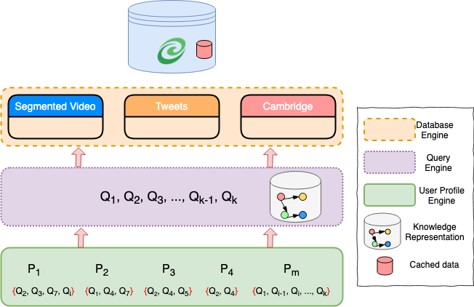
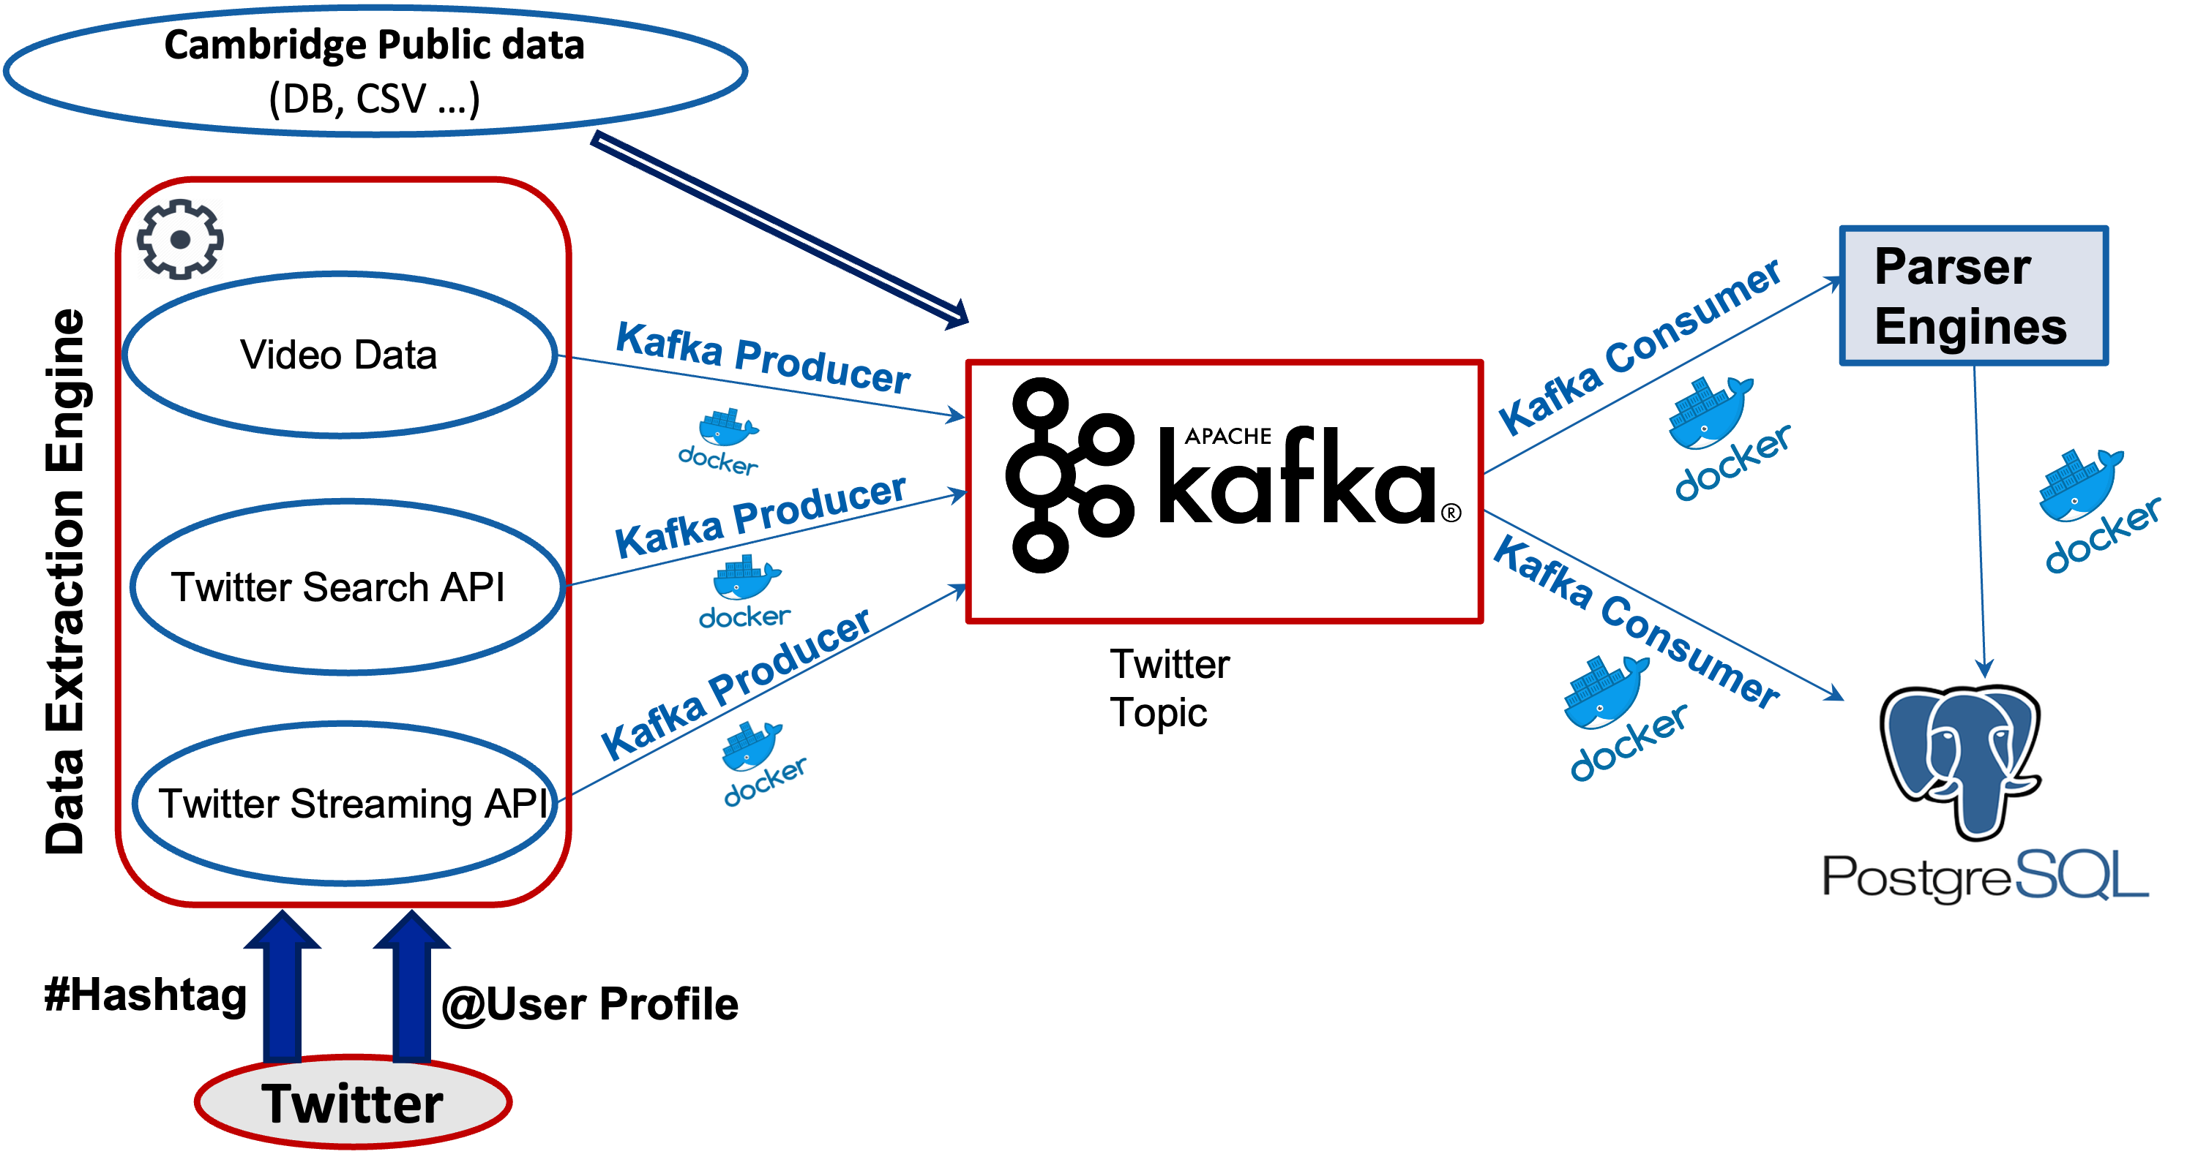
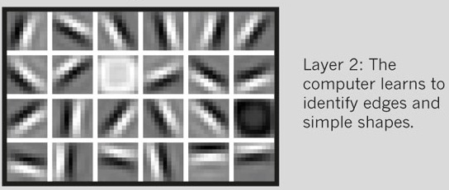
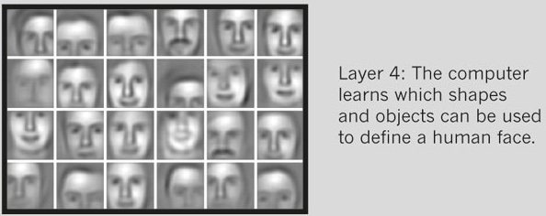
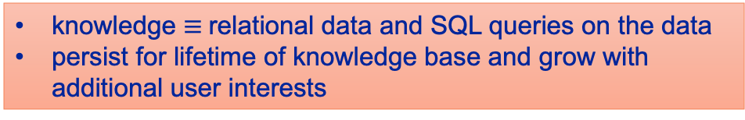
Solutions
Generalizable representation for content and context
Using low level features vs high level semantic features
Connect user information need with the representation
Novel method digesting both streaming and at-rest data and creating a stable ingest process for data
Scalable Data integration and Data Storage process to petabytes of data
Creating adaptable knowledge base using historical queries and user preference
Methodology to fulfill current needs with existing incomplete modalities and deliver data as it arrives
High-level Semantic Feature for Data Representation
Interpretability
Explainable by interrogation
Explainable by design
Scalability
Compatibility with SOTA models
Context Representation
User uploads example or semantic features
Query-by-example or Query-by-feature
Database Trigger
Replicable, Fault tolerant, Scalable and Continuous
Multimodal Query Engine
knowledge $≡$relational data and SQL queries on the data
persist for lifetime of knowledge base and grow with additional user interests
* https://www.nature.com/articles/505146a
Notes:
Original: https://www.nature.com/articles/505146a
https://www.baeldung.com/cs/cv-low-vs-high-level-features
https://thecustomizewindows.com/2015/07/what-is-deep-learning-or-deep-machine-learning/
Faces - https://pdfs.semanticscholar.org/ccea/50570609ef5b6acbb1d789abab90276ba8ac.pdf
Faces2 - https://www.sciencedirect.com/science/article/abs/pii/S1047320315001583

Slide 15
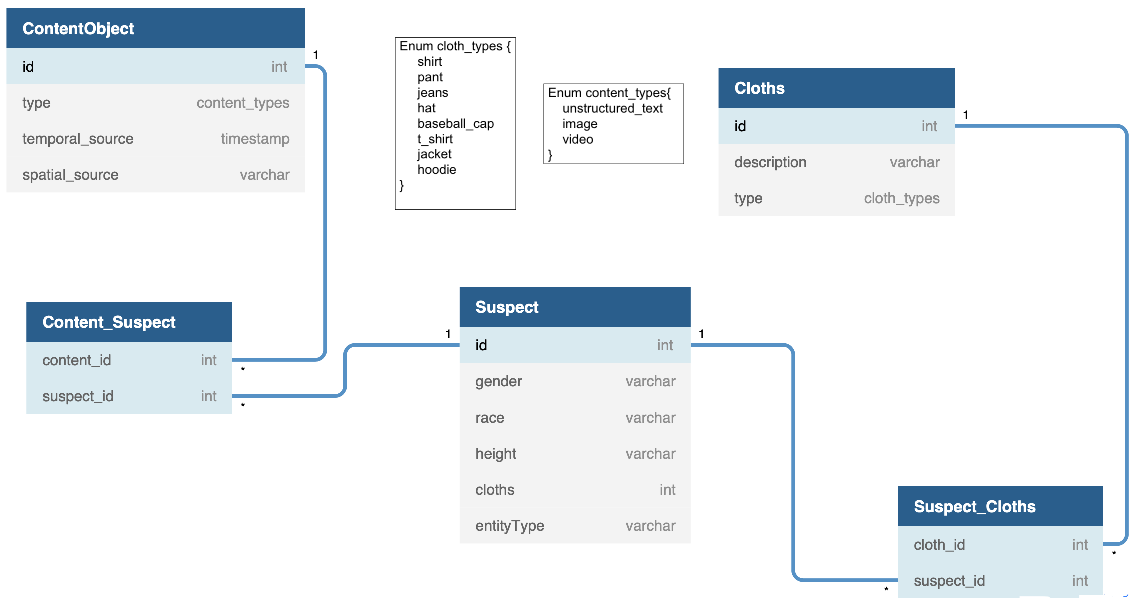
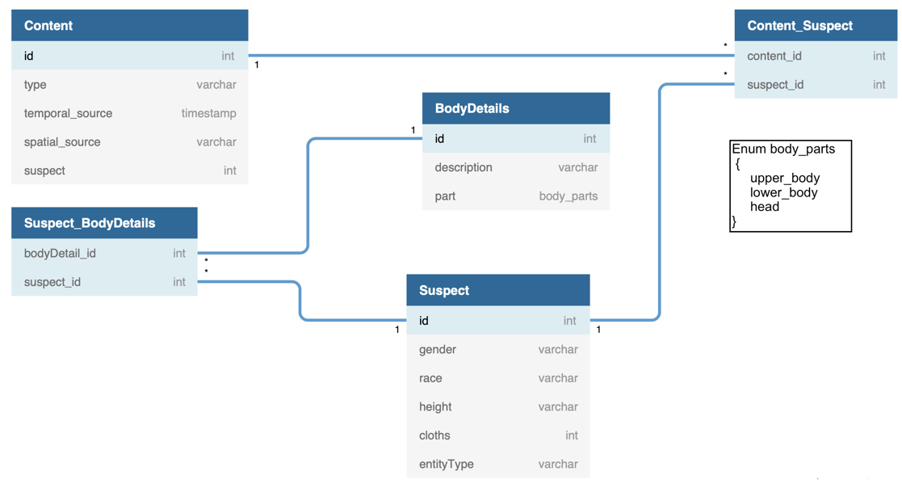
Knowledge Modeling for Multiple Modalities Data Integration
Multimodal Query Engine
Feature Extraction
Data Integration and Relevance Learning
Challenges
Different Schema / Feature-name in different modalities
Solution
View-based Data Integration
Schema Mapping
SQL-JOIN
Text Feature Schema
Video Feature Schema
Notes:
SurvQ or Urban info. Knowledge base /
Data Integration
Generalizable
Uses Features
Learnable
We implement a nested loop join on relations from each modality and the incident relation. Each queried missing person incident are converted into relation R with features F1, F2, . . . , Fm. Features from modalities are translated into relations T1, T2, . . . Tn, where n is the number of modalities in the system. We perform a join between R and each Tk (k ≤ n) using the join predicate JP on all queried features,
For example, in Figure 3.2, features from the video feed are translated into relation T1, and features extracted from the incident report are translated into relation T2 after schema mapping. If the user is interested in a person with features F2, F6, . . . , Fi, we create a JOIN query over all the translated relations and the incident relation on features F2, F6, . . . , Fi.

Slide 16
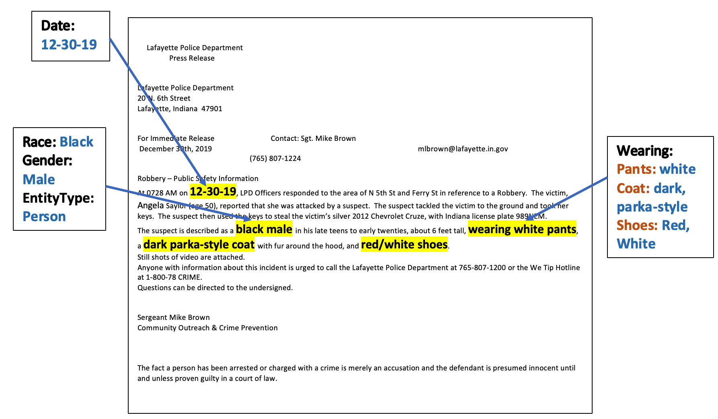
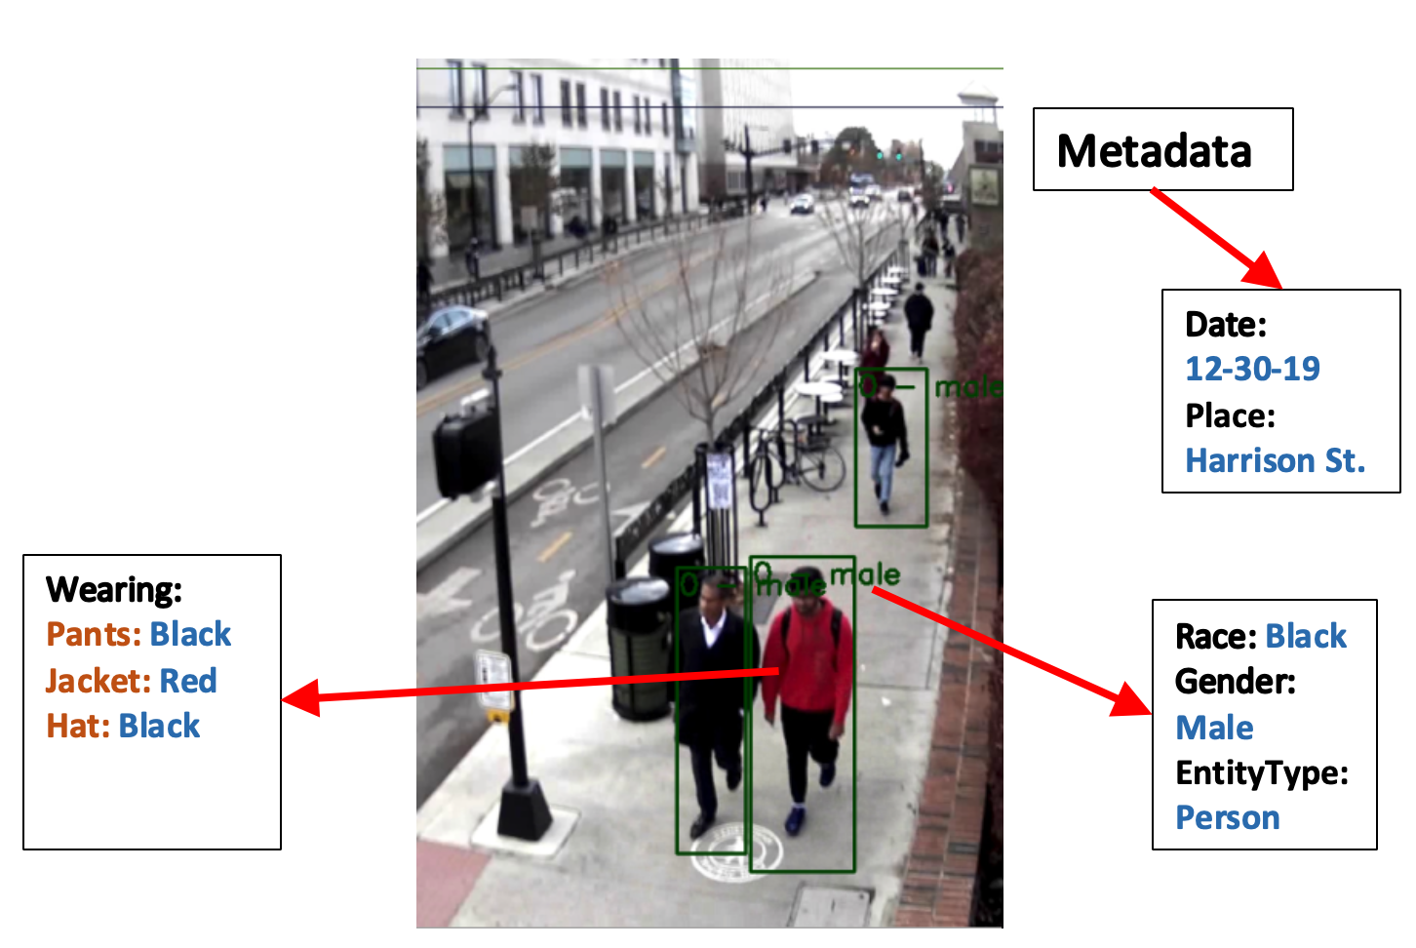



Data Fusion and Relevance Matching with EARS
Schema Mapping
Streaming Input or Data-at-rest
Video Schema
T₁
T₂
Global
Schema
?
User Input
Pattern Matching with SQL-JOIN and Predicates
F₂ , F₆ , F_{i}
F₂ , F₆ , F_{i}
T₁ ⨝ T_{2 ……} ⨝ T_{k}
Results
Content Relevance Discovery
Text
Schema
F₂ , F₆ , F_{i}
Triggering Events
Extracted Features
Features are extracted from raw input
Notes:
We create a global schema from user input/ incident
Map the features to global schema

Slide 17
SKOD Architecture
Main Components
Data Capture and Ingestion
Broker
RDBMS data store
Multimodal Query Engine
Feature Extraction
Knowledge Modeling
Relevance Learning
Data Fusion
Data Retrieval
Triggers
Cache, MRQ

Slide 18
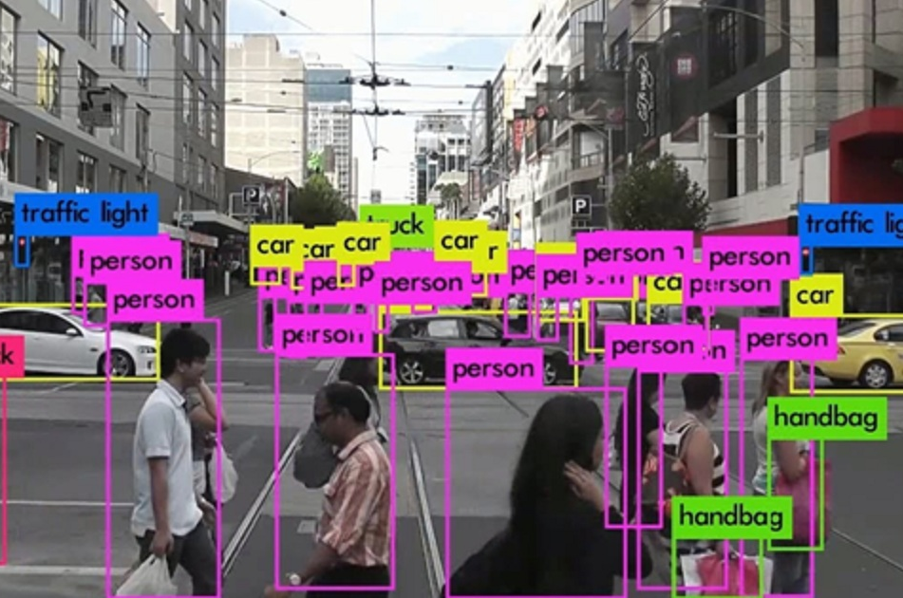
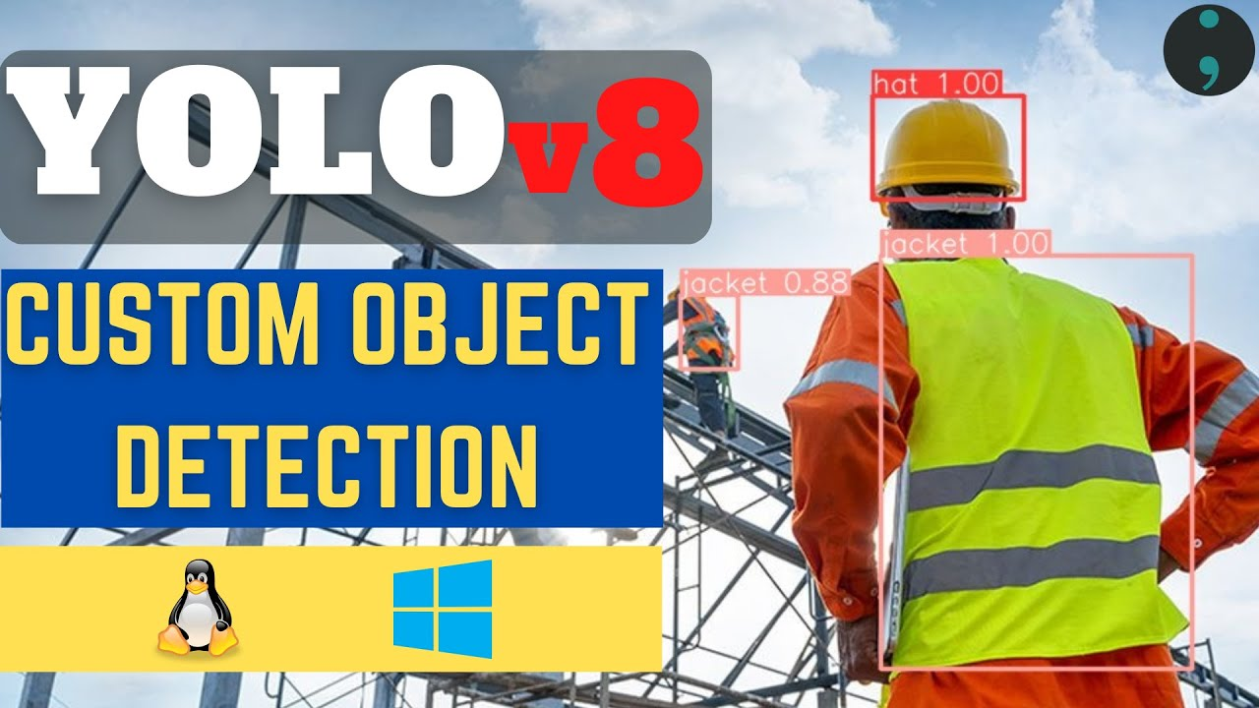

Video and Image Feature Extraction
Objects / Domain-Independent
Attributes of Objects / Task-specific
Person, Car, etc.
Low Video Quality
Augmentations for Scalability
Gender, Clothes, Age, etc.
Model, Make, Color, etc.
Training Strategies
Retrain, Transfer Learning, Similar Domains
Notes:
person
bird, cat, cow, dog, horse, sheep
aeroplane, bicycle, boat, bus, car, motorbike, train
bottle, chair, dining table, potted plant, sofa, tv/monitor
https://www.youtube.com/watch?v=gRAyOPjQ9_s

Slide 19

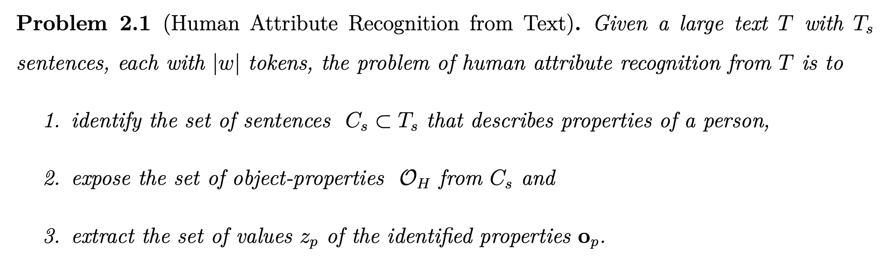
Human Attribute Extraction from Text (HART)
…………
a white male with medium build was seen in Vernon St., wearing white jeans and blue shirt
………….
1. gender = male, 2. race = white, 3. build = medium, 4. ∗clothes = {jeans, shirt}, 5. upper-wear-color= {white}, 6. bottom-wear-color = {blue}, and 7. relation = {wearing, †Person, ∗Clothes}.
Notes:
Such as, gender

Slide 20
Human Attribute Extraction from Text (HART)
Assumptions
Set of Key-phrases used to describe object properties are known from
Domain experts, or
From a very small amount of annotated documents
Observations
Feature values can have single and multiple tokens
Some features follow specific patterns
Adjective describes feature-value, or is used with Noun phrase to modify it
Feature values can span multiple tokens, but they are consecutive

Slide 21
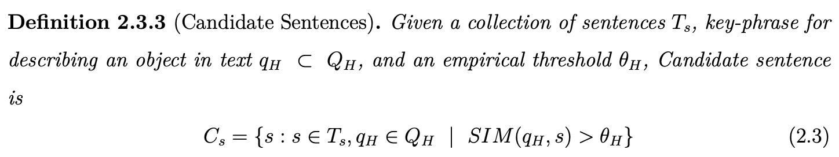
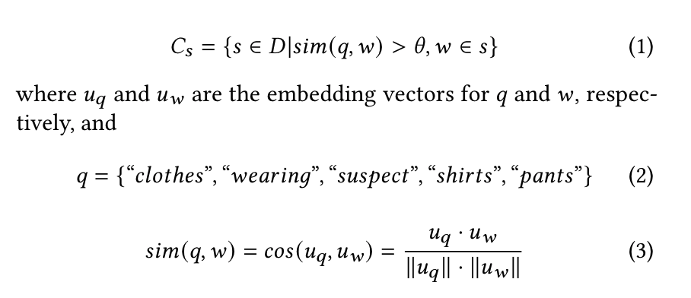
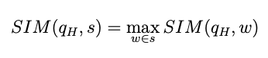
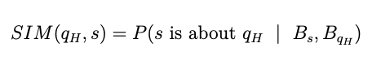
Candidate Sentence Extraction
Key Phrases describing Attributes
Regex
Word2Vec
Wordnet
SBERT NLI Classifier
Classification Task
On Sentences
Notes:
Similarity between word meanings refers to a relative distance between these word meanings in the hypernym tree
Nli and SBERT
Wordnet: Lexical Knowledge Base

Slide 22
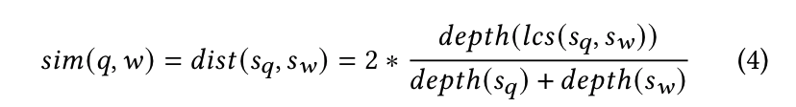
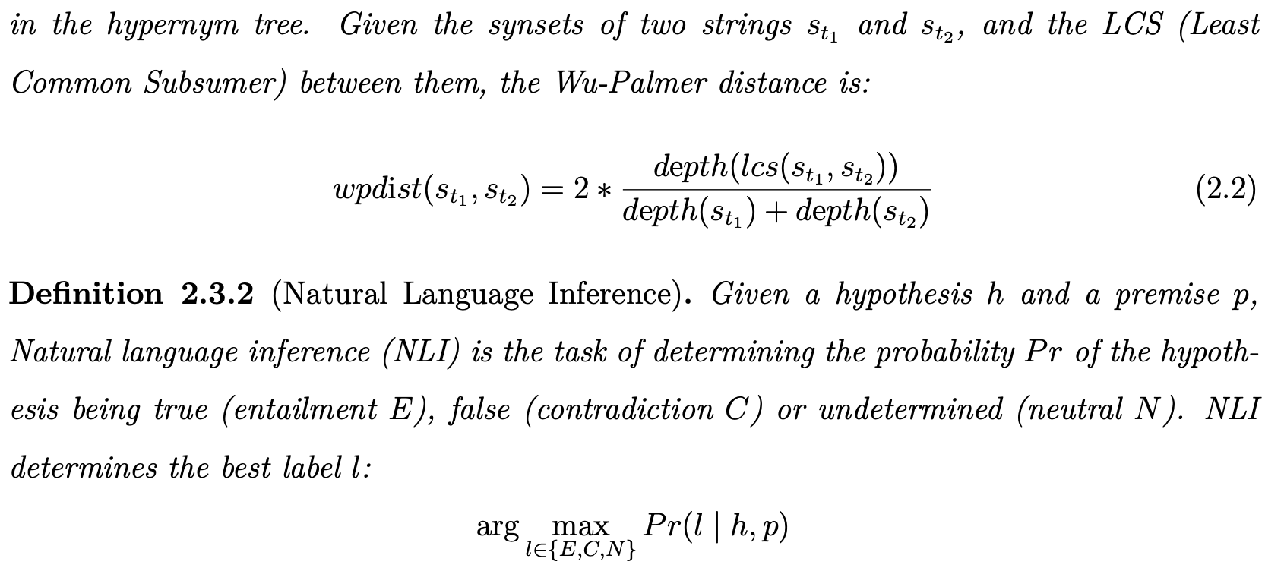

Slide 23
Feature Value Extraction
NP
VBG
ADJ
Noun
…………
Suspect was a white male, wearing buttoned-up shirt and blue jeans.
………….
POSID
ADJ
Noun
Generalize for any domain
Based on Key Phrases

Slide 24
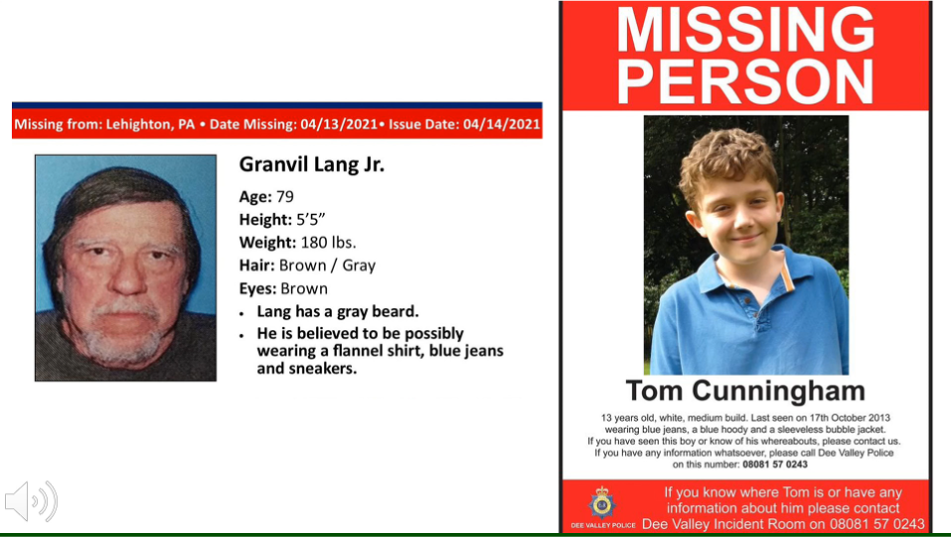
Demo + Evaluation Setup
Two Use Cases
Video Querying System
Finding Missing Persons
GCP for hosting
Data Storage (Postgres)
Property Identifiers
9 Compute Engines
1 SQL instance, 1 Storage Bucket
Video Feature Extractor Benchmark
OS: Linux Ubuntu 18.04
GPU: Tesla K80 with 12GB Memory
The goal is to demonstrate the feasibility of the proof of concept with real use cases deployed using SKOD
Notes:
Google Cloud Paltform

Slide 25
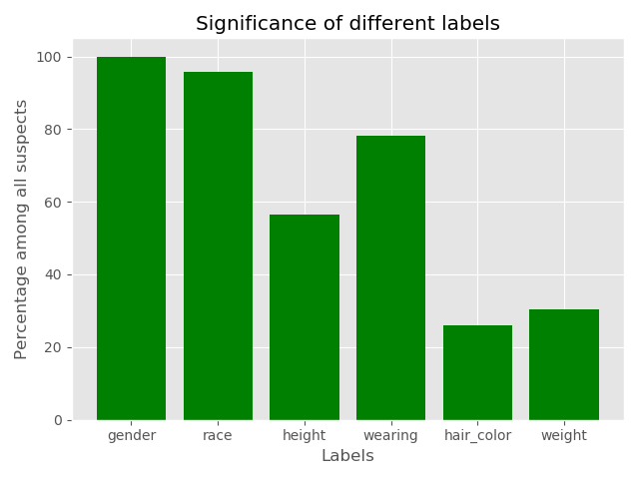
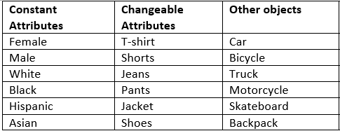
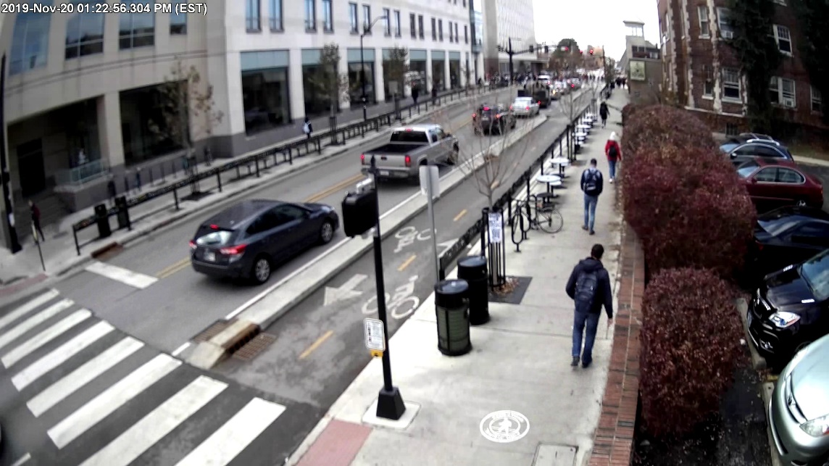
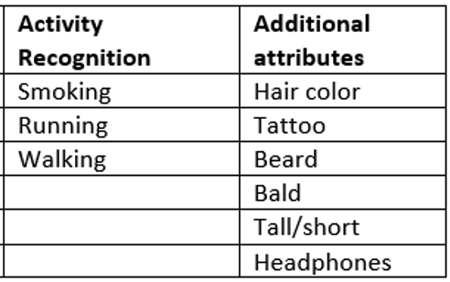
Mission needs for Video Querying System & Missing Person Search
Data Annotation
Gender, Race, Age, Hair Color,
Clothing (jacket/pants/jeans) and Cloth-details
Multiple persons are described in same document and annotated separately

Slide 26
Feature Extraction Models
Image/ Video Feature Extraction
Conventional Deep Learning
YOLO trained from scratch for the novel features
Pixel Analysis
Domain specific color-sampling and heuristic based method
Feature mapping
Using Attribute detection models for similar domain-specific features
Text Feature Extraction
HART
Candidate Sentence Extraction
Regular Expression
SBERT
Attribute Value Extraction
Syntactic Model
POSID
Three Models based on YOLO/CNN
Notes:
Transfer Learning – YOLO re-trained for the novel features

Slide 27
Datasets
Types of Data
Traffic Camera Video
Dashcam Video
Incident Reports
Officer narrative
Press Release
Newspaper Articles
Tweets
City Management Data (Structured Data)
Dataset Size
~600K tweets
100+ hours of dashcam video
10+ hours of Traffic Cam Video
2000+ pairs Multimodal Data
WLPD
Location
Real World Datasets
Cambridge, MA
West Lafayette, IN
WLPD
Notes:
West Lafayette Surveillance Videos, and Police Reports

Slide 28
Datasets
Datasets
Real World Data Sets
Tweets about Cambridge City (~600K tweets), Cambridge City Management Data (Structured Data), 100+ hours of dashcam video collected at MIT
West Lafayette Police Department Surveillance Video
Training data: 30+ hours of labeled video
Test data: 15-minute videos, separated in 300 frames
20+ hours of unlabeled video
Incident Reports from West Lafayette Police Department
Incident Reports, Officer narrative, Press Release, Newspaper Articles
For multi-modal content extraction, incident reports contribute to 2000+ pairs
60% as training data, 20% as testing data
Notes:
West Lafayette Surveillance Videos, and Police Reports

Slide 29
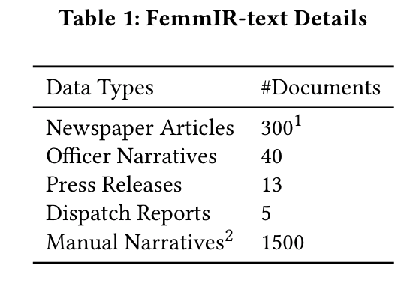
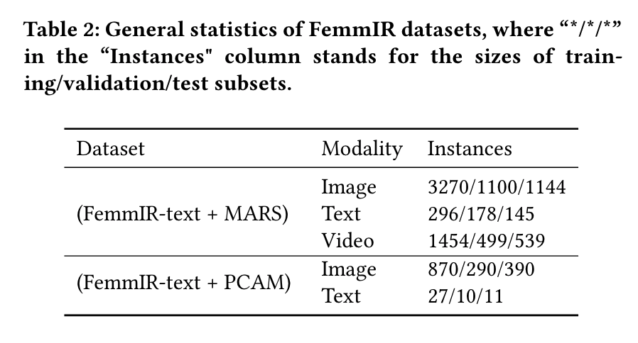
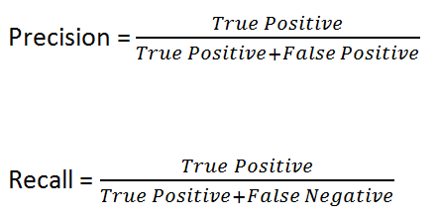
Datasets For Text Attribute Extraction and Multi-modal Fusion
Clothes are evaluated on
Attribute Name (How many correct clothes were identified in the reports)
Attribute Value (How many details of those correctly identified clothes were detected)

Slide 30
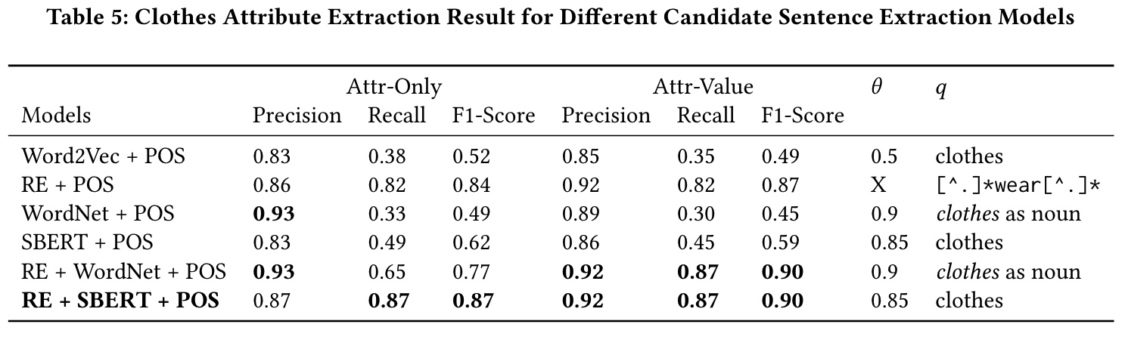
Experimental Results and Findings
RQ1: Which is a better representation of tokens for finding key phrases – lexical or contextual model?
Attribute-Only: #identified clothes
Attribute-Value: #details of identified clothes
Findings: Wordnet understands similarity in meaning better than word2vec, as we can see we lowered threshold for word2vec quite a lot, but still Wordnet + POS worked better.
* Solaiman et al., Feature-centric Multimodal Information Retrieval (FemmIR), submitted in SIGMOD 2023
Notes:
Synset : a set of synonyms that share a common meaning.

Slide 31
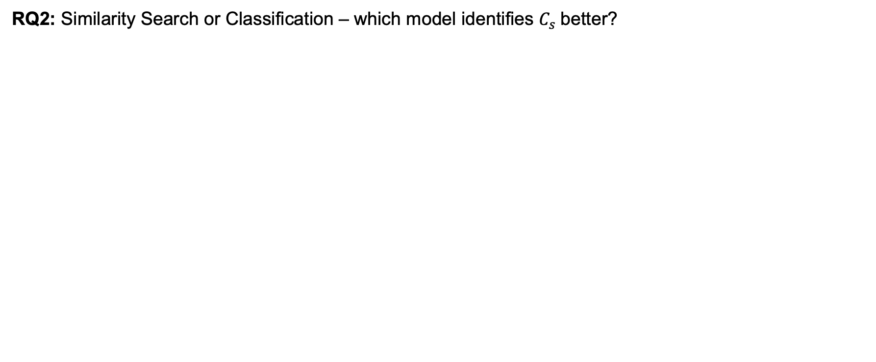
Experimental Results and Findings
RQ2: Similarity Search or Classification – which model identifies $C_{s}$better?
Findings: Although SBERT identifies lesser number of relevant items than similarity search with WordNet, higher recall indicates SBERT identified lesser number of irrelevant data than WordNet.
* Solaiman et al., Feature-centric Multimodal Information Retrieval (FemmIR), submitted in SIGMOD 2023
Notes:
Synset : a set of synonyms that share a common meaning.
high recall means that an algorithm returns most of the relevant results (whether or not irrelevant ones are also returned).
Higher precision means that an algorithm returns more relevant results than irrelevant ones

Slide 32
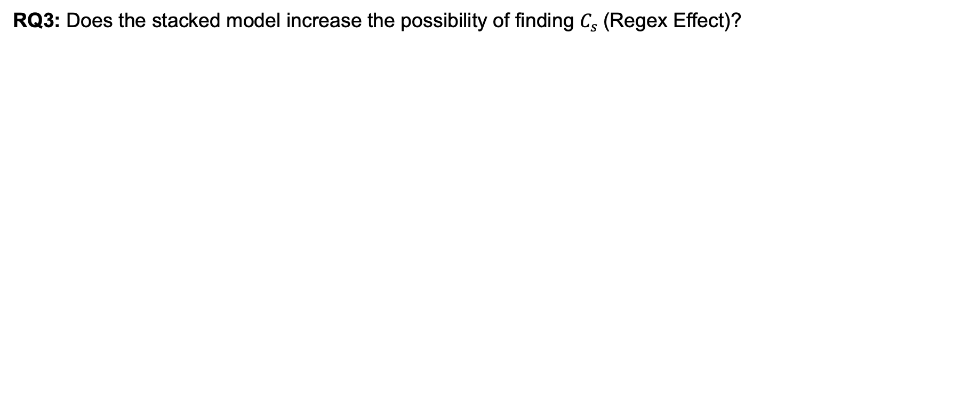
Experimental Results and Findings
RQ3: Does the stacked model increase the possibility of finding $C_{s}$(Regex Effect)?
Findings: Most definitely Regex search combined with another layer of WordNet/SBERT increases the possibility of finding the correct $C_{s}$as unstructured text will most definitely would have noisy texture and style.
* Solaiman et al., Feature-centric Multimodal Information Retrieval (FemmIR), submitted in SIGMOD 2023
Notes:
Synset : a set of synonyms that share a common meaning.
Regular Expressions (key-phrase search)

Slide 33
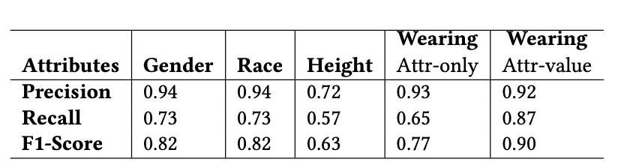
Experimental Results and Findings
RQ4: Is there any consecutive presence of features in the unstructured text in the writing style of different persons?
Findings: Gender and Race appears together in most of the cases, as is apparent from the 82% F1-score as we designed the regex search for gender and race codependent on one another, i.e., a white male with medium build was seen in Vernon St., wearing white jeans and blue shirt.
* K. Solaiman, T. Sun, A. Nesen, B. Bhargava and M. Stonebraker, "Applying Machine Learning and Data Fusion to the Missing Person Problem" in IEEE Computer, vol. 55, no. 06, pp. 40-55, 2022.
Notes:
Synset : a set of synonyms that share a common meaning.
Regular Expressions (key-phrase search)

Slide 34
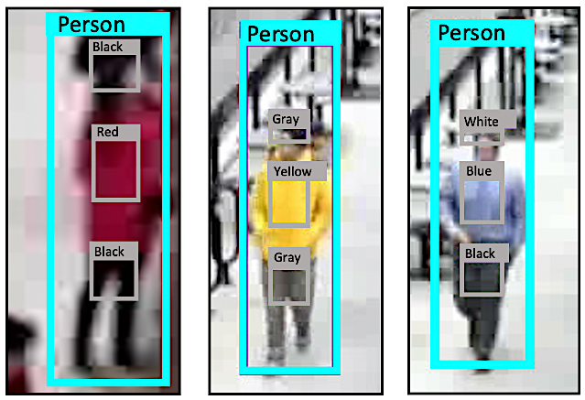
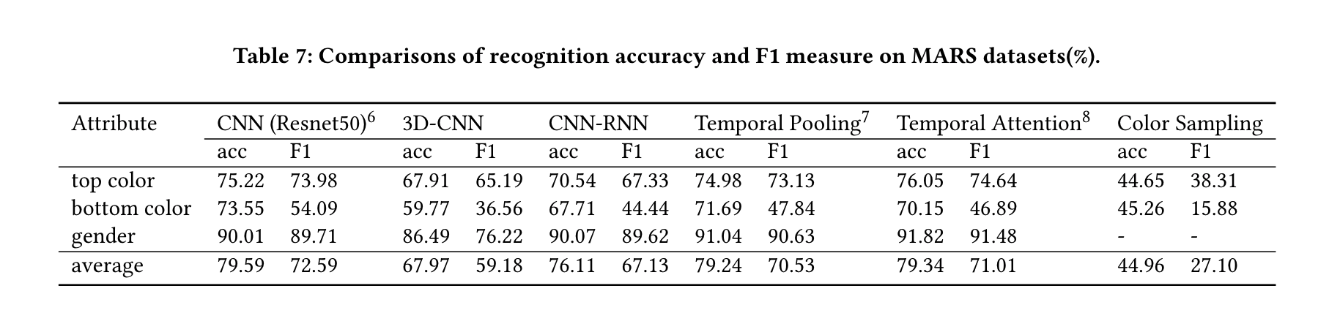
Experimental Results and Findings
RQ4: Which one is the best method for video attribute detection in Person Querying System?
Resnet50 needed 513 minutes and temporal attention model needed 1073 minutes for training
* MARS (Motion Analysis and Re-identification Set)
s
s
s
Findings:
If only static features are of interest i.e., gender, CNN-based object detectors are enough.
If static and dynamic features (have effects from time and space) are of interest, CNN with temporal attention works better.
Findings:
On average, CNN with temporal attention is a better method for human attribute detection from videos.
Findings:
Color Sampling can be a good solution for cold start problem, but compared to neural network models the performance is weak.
* K. Solaiman, T. Sun, A. Nesen, B. Bhargava and M. Stonebraker, "Applying Machine Learning and Data Fusion to the Missing Person Problem" in IEEE Computer, vol. 55, no. 06, pp. 40-55, 2022.
Notes:
Color Sampling can be a good solution for cold start problem, but compared to neural network models the performance is weak.
On average, CNN with temporal attention is a better method for human attribute detection from videos.
We follow the original train/test partition of MARS dataset for benchmarking. For models in [114–116], we formed a training batch by randomly selecting 32 tracklets, and then by randomly sampling 6 frames from each tracklet. During testing, F frames of each tracklet are randomly split into ⌊ Fn ⌋ groups, and the final result is the average prediction result among these groups. We used a validation set of mutually exclusive 125 people selected from the training set. For color sampling, we used the result from the first frame from each tracklet. We compared three properties across all models - gender, top color and bottom color.

Slide 35
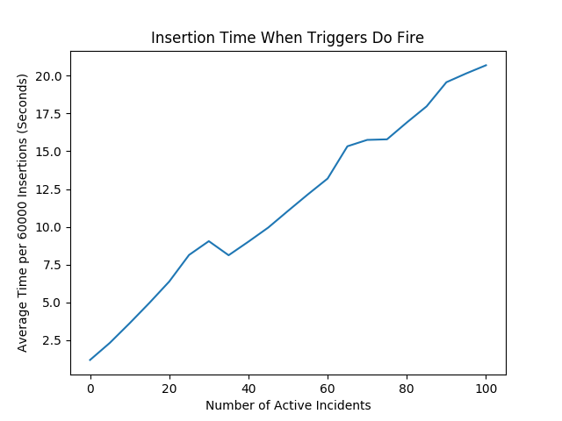
Experimental Results and Findings
RQ5: Will SKOD / SurvQ be performant enough to handle an urban camera deployment, including the West Lafayette use case?
In SurvQ, a trigger function for each incident is invoked every time YOLO results are inserted.
YOLO runs on 60 frames per minute
Avg. 5 persons per frame
At most 200 video sources
~ 60 * 5 * 200 = 60000 inserts per minute
Handle under 60 seconds
Findings: Since avg time/60K inserts is well under 60 seconds, we can most definitely say the trigger invocation can easily keep up, and so would SKOD.
* M. Stonebraker et al, Surveillance Video Querying with a Human-in-the-loop, in HILDA, SIGMOD 2020
Notes:
We have run our ingest system and our query system in parallel on real and simulated queries and data. To assess performance, we consider SurvQ as three components: video ingest, YOLO processing, and database activity. Our goal was to make SurvQ performant enough to handle an urban camera deployment, including the West Lafayette use case.
We maintain a collection of web servers to handle video upload. Upsteam processing must generate video in 1-minute MP-4 files. Future work would be required to handle other video formats. A low cost web server can support 4-5 concurrent video feeds.
YOLO processing runs well on a GPU-equipped server. A single server can perform object recognition and color analysis in approximately 15 seconds per 1 minute of video. Thus, each YOLO processing server can handle around 4 incoming feeds.
Our major performance concern was how our use of trigger functions in Postgres would scale. In SurvQ, a trigger function for each incident is run every time YOLO results are inserted. We run YOLO on video at a rate of 1 frame per second, or 60 frames per minute. West Lafayette surveillance data averages 5 persons per frame. Since the West Lafayette use case has at most 200 video sources, we would expect our system to receive around 60 * 5 * 200 = 60000 inserts per minute. We need to be able to handle these insertions in under 60 seconds worth of time. Figure 2.14 shows that trigger invocation can easily keep up.

Slide 36
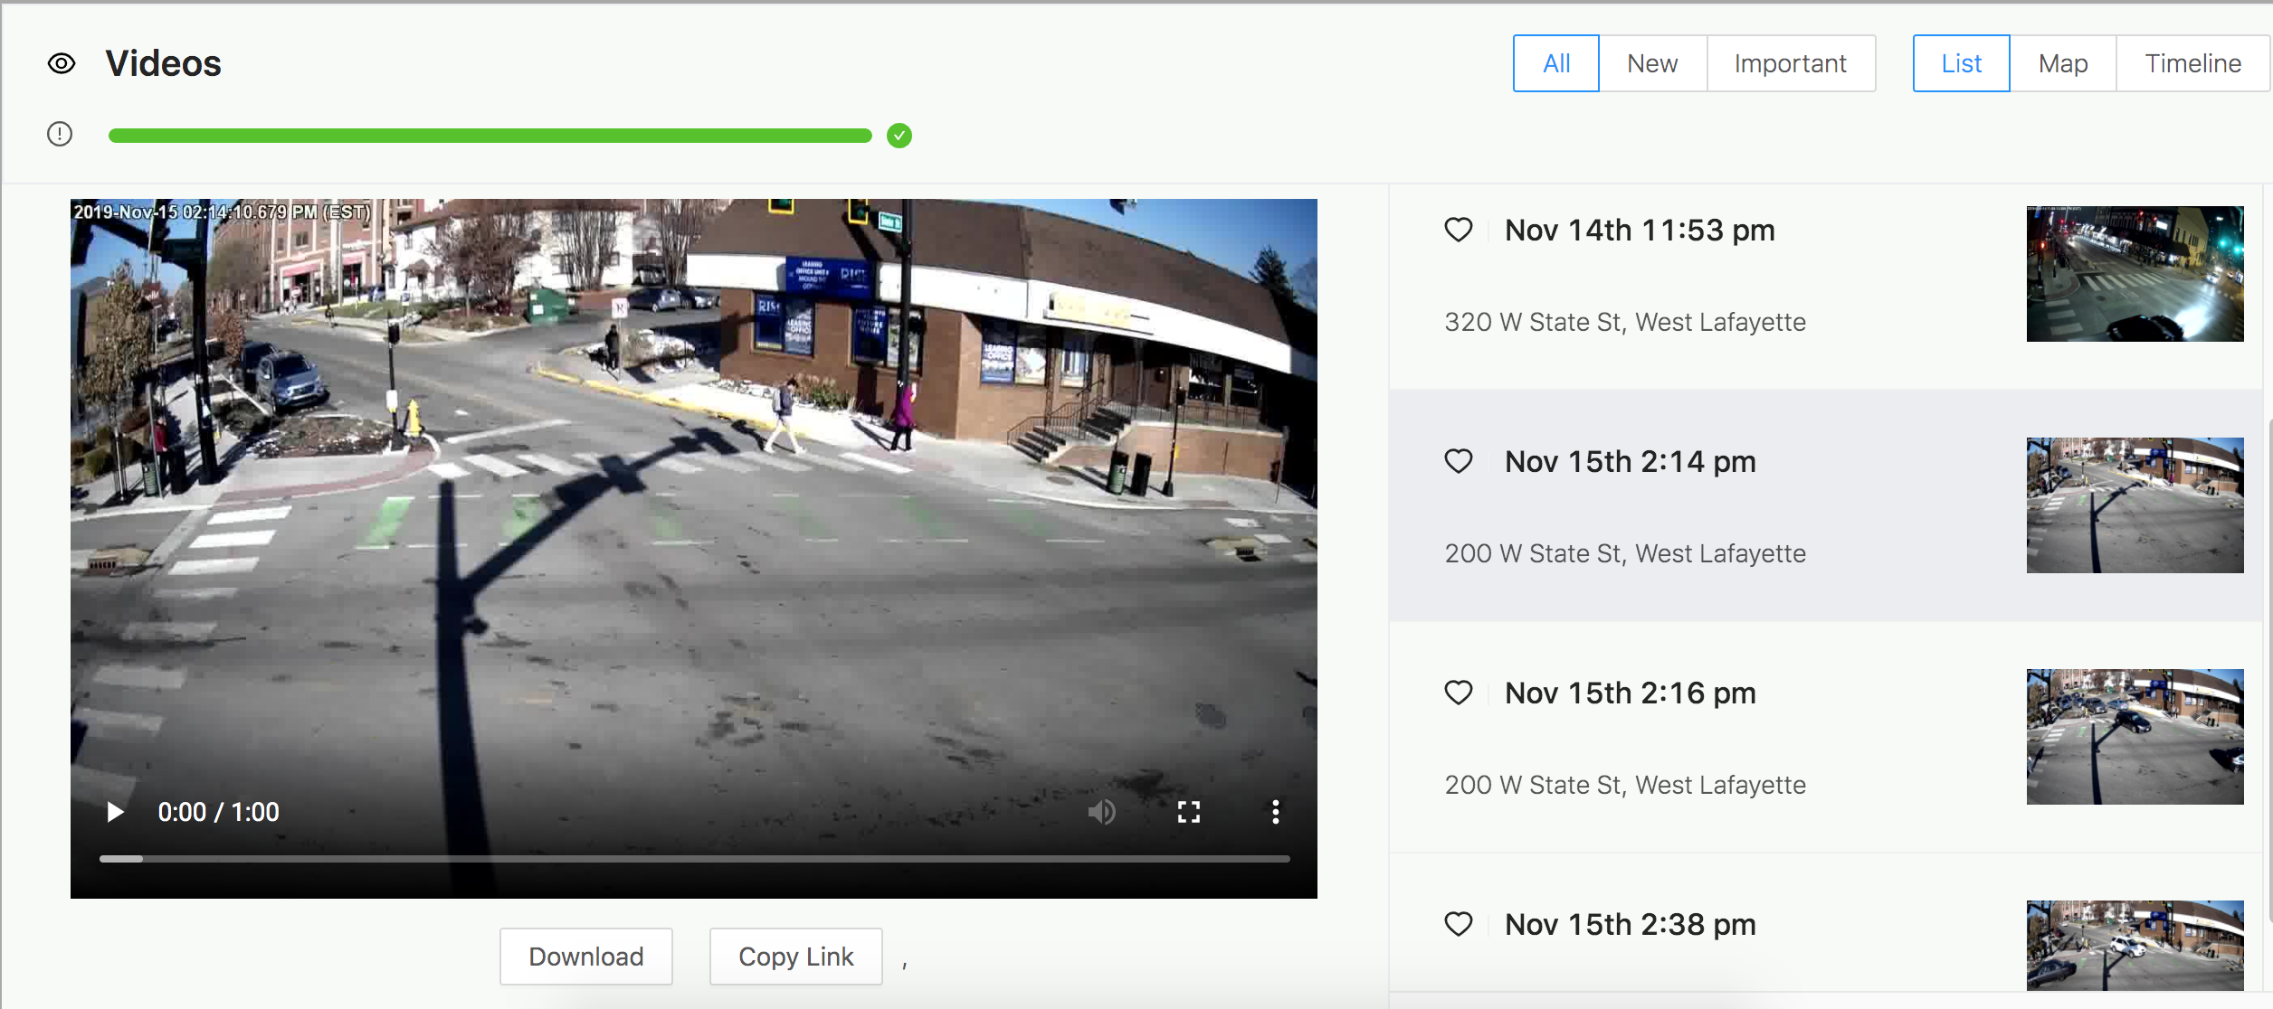
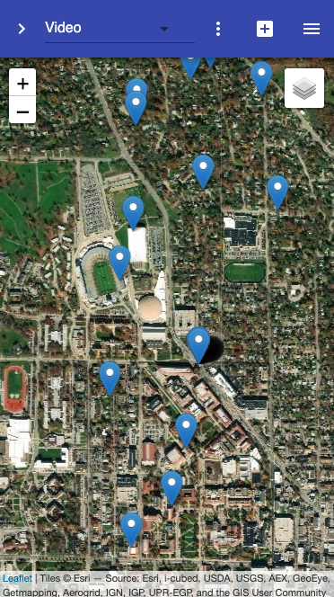
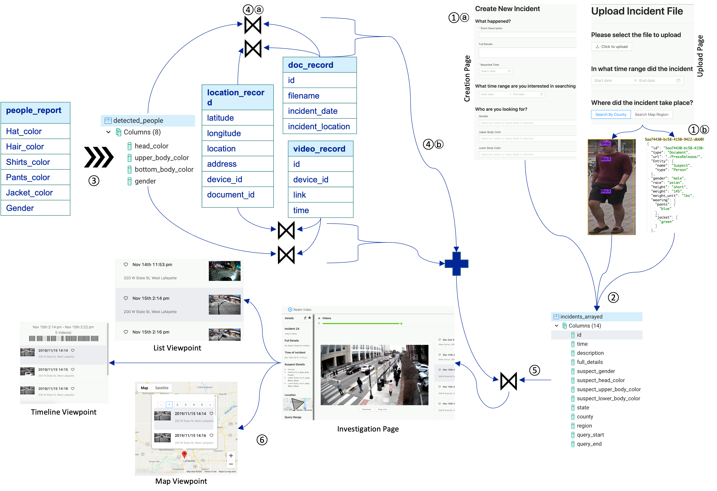

Experimental Results and Findings
RQ6: Can SKOD framework be generalized?
solving missing person problem + Vt's 1947 cold case
Urban Information System
Video Querying System
Missing Person Search
Find-Them
S. Palacios and K. Solaiman** et al. SKOD: A Framework for Situational Knowledge on Demand. In Poly 2019, at VLDB 2019, August 2019.
M. Stonebraker et al, Surveillance Video Querying with a Human-in-the-loop, in HILDA, SIGMOD 2020.
K. Solaiman, T. Sun, A. Nesen, B. Bhargava and M. Stonebraker, "Applying Machine Learning and Data Fusion to the Missing Person Problem" in IEEE Computer, vol. 55, no. 06, pp. 40-55, 2022.
Notes:
NM is gathering information for a missing persons database.
I work at DOIT/State of NM in Santa Fe on computer databases.
I use Azure Data Studio notebooks to connect data.
https://learn.microsoft.com/en-us/sql/azure-data-studio/notebooks/notebooks-guidance?view=sql-server-ver16
I developed DNA genome assembly tech for the US Human Genome Project at LANL.
Capt. Teresa Randall Staff Operations Commander Office of Technology Management Vermont State Police (VSP)
Harold M. "Hal" Frost, Ph.D. (physics) P.O. Box 162
(# 3215 Vermont Rte. 122) Sheffield, VT 05866 USA Tel -- (802) 626-3508 (e-mail preferred) -- Retired from University of California in 2008, via LANL -- Life Senior member, IEEE -- Triple alum of UVM (1964; 1969; 1974)
-- Viet Nam Era veteran (USAR Capt.) -- Disabled -- IEEE = Institute of Electrical and Electronics Engineers -- LANL = Los Alamos National Laboratory -- UVM = The University of Vermont
-- Message is in RTF

Slide 37

Research Contributions
Novel scalable, real-time situational knowledge extraction and dissemination engine that can process multi-modal knowledge and can deliver information need over time from temporarily absent modalities
First attribute recognition model from unstructured large text
Novel real-world datasets for multimodal information retrieval with image, text and video
Prototypes with a variety of applications
Surveillance Video Querying
Finding Missing Persons
Medical Triage, Search and Rescue in Disasters, Classroom teaching
Impact: SKOD can automate open problems that required large-scale human endeavor and resources, including in data discovery and decision-making
Notes:
Unclassified national information sharing system that enables criminal justice agencies to search, link, analyze, and share local, state, tribal, and federal records.
Strategic investigative information sharing system that fills informational gaps and provides situational awareness.
Locate Missing Person for
Person Re-location during Disaster
Amber Alerts
Aged Person Identification
Missing Kids
Drone Surveillance for Search and Rescue in Disasters
Resource Distribution during Disasters

Slide 38


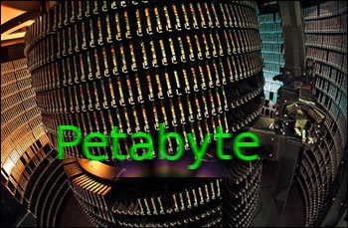






Contribution #2: Label Independent Data Integration

Slide 39
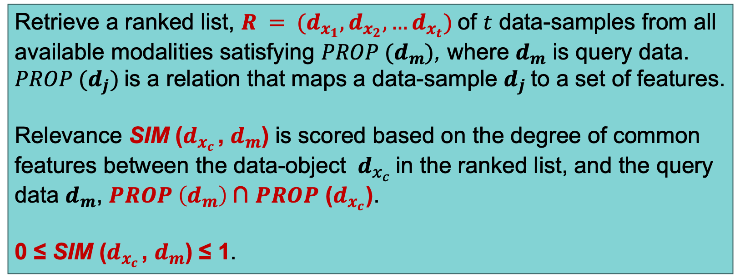
Problem Statement and Motivation
Desirable properties for Data Integration in Decision Making
Generalizable across modalities
Learnable and should use past experiences
Scalable
Data Integration for SKOD should
Consider context information (query example) in relevance matching
Use high-level semantic features to be compatible with SKOD framework
Have Approximate matching and Ranking
Correlation learning, Metric learning, Encoding Networks fail to do so for situational knowledge, and rely on labels
Retrieve a ranked list, $R = (d_{x_{1}},d_{x_{2}},…d_{x_{t}})$of $t$ data-samples from all available modalities satisfying $PROP (d_{m})$, where $d_{m}$ is query data. $PROP (d_{j})$is a relation that maps a data-sample $d_{j}$to a set of features.
Relevance SIM ($d_{x_{c}}$ , $d_{m}$) is scored based on the degree of common features between the data-object ${ d}_{x_{c}}$in the ranked list, and the query data $d_{m}$, $PROP \left(d_{m}\right) \text{∩}$ $PROP$ ($d_{x_{c}}$).
0 ≤ SIM ($d_{x_{c}}$ , $d_{m}$) ≤ 1.
Notes:
${ d}_{x_{c}}$ is c-th data in R from modality $x_{c} ∈_{R}M$
A similarity score is used to define the degree of relevance,

Slide 40
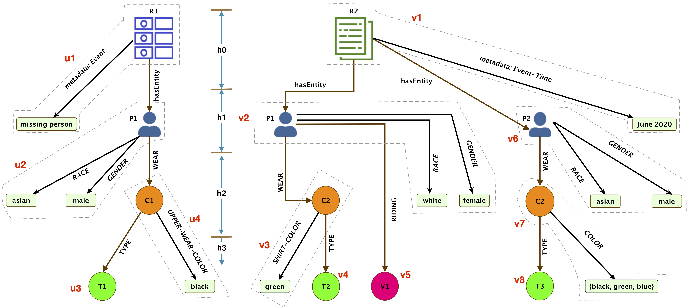
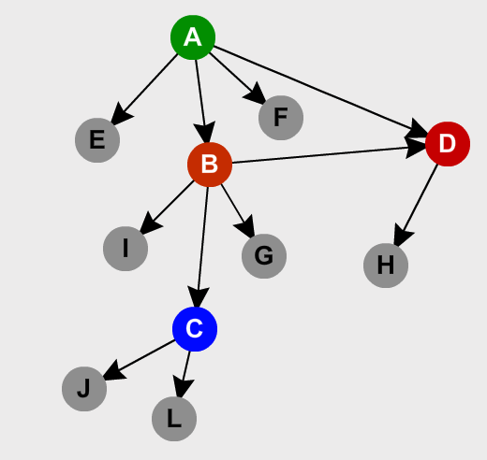
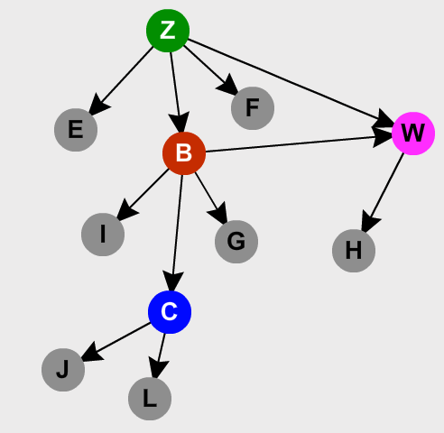
Relevance Matching with Graph Representation Learning
Streaming Input or Data-at-rest
ROOT
Extracted Features
F₂ , F₆ , F_{i}
Metadata
User Input
 | 0.95
 | 0.70
 | 0.63
Deliver Content with Ranking
EPL Vertex
0.95
0.0
0.70
0.63
0.40
Filtering
Feature Values
Relevance Matching
Graph Matching and CED Approximation
Features are extracted from raw input
Notes:
intuition here is that entities, relationships, and object-properties in a data sample have a inter-connected structure and if we can capture the changes we need to make to this structure to convert it to structure of another data-sample, then we can capture the differences between these samples. Based on this intuition, FemmIR starts by constructing a hierarchical attributed relational graph, called (HARG), with a common hierarchy for all data samples. The choice of graph as a representation was influenced by:
1. graph being the best data structure to capture information from connected structures,
2. based on observations O4.2.3 and O4.2.5, a data structure with representation- invariant encoding mechanisms that can capture the syntactic similarities between different values was necessary.

Slide 41
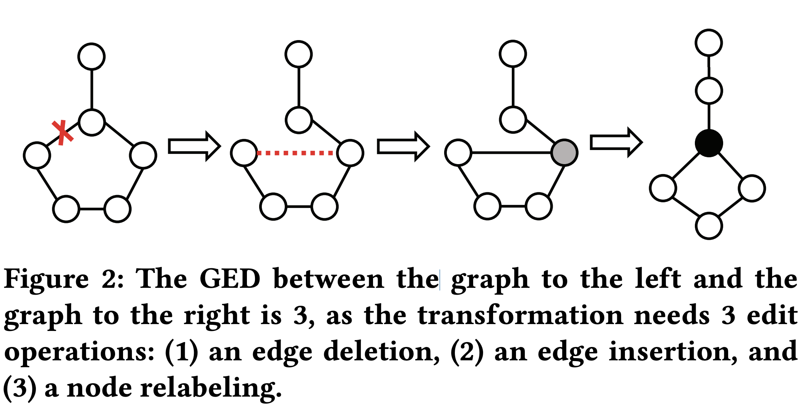
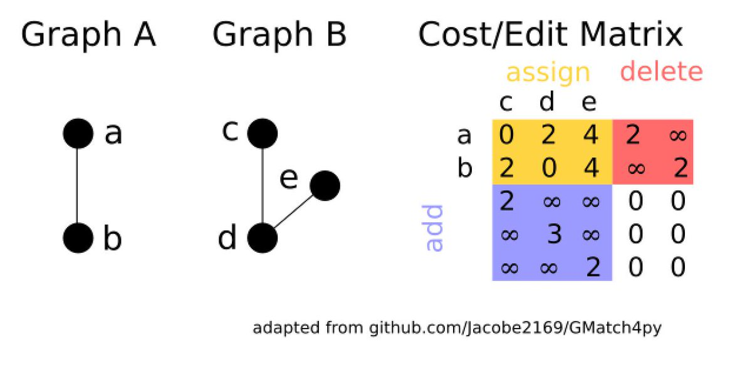
Content Edit Distance (CED)
Different nodes and edges has different change cost
Feature replacement cost is an input
GED calculation algorithms (A*-search, VJ, or Beam) speed increase with #nodes
HARG is variable sized
Edge replacement cost considers both participating nodes
Multi-valued features need change cost, not replacement cost
* SimGNN: A Neural Network Approach to Fast Graph Similarity Computation. Yunsheng Bai, Hao Ding, Song Bian, Ting Chen, Yizhou Sun, Wei Wang. WSDM, 2019.
Notes:
Can be any language embeddei
Estimating content edit distance instead of a simple property-
to-property comparison allows the flexibility to consider the dependency between prop-
erties and graph levels.
Using Adjacency-Munkres from [92] allows us to find the optimal assignment of each EPL vertex without taking into account the dependency among them
We use Munkres to get an approx. CED, but we need to populate the cost matrix for that, and we do it in a certain manner.

Slide 42
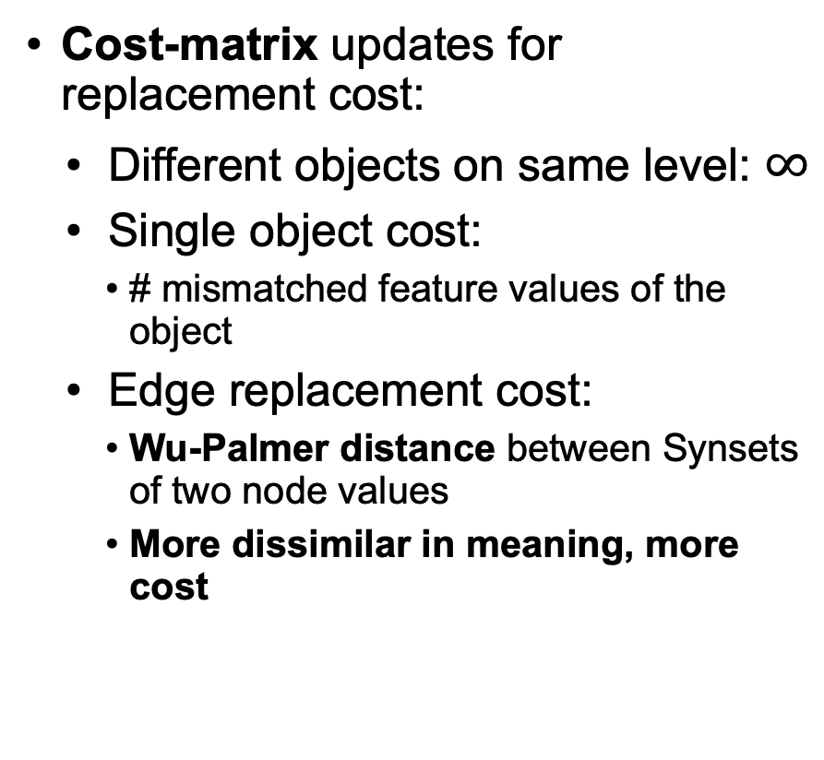
Content Edit Distance (CED)
Cost-matrix updates for replacement cost:
Different objects on same level: $∞$
Single object cost:
# mismatched feature values of the object
Edge replacement cost:
Wu-Palmer distance between Synsets of two node values
More dissimilar in meaning, more cost
Cumulative Munkres
Each data can contain multiple objects
Add that cumulative info to root
Add the dependency information into the cost-matrix
Levels from HARG
Parent EPL-vertices assignment cost are added to child EPL-vertices, starting from EPL-vertices in level-1.

Slide 43
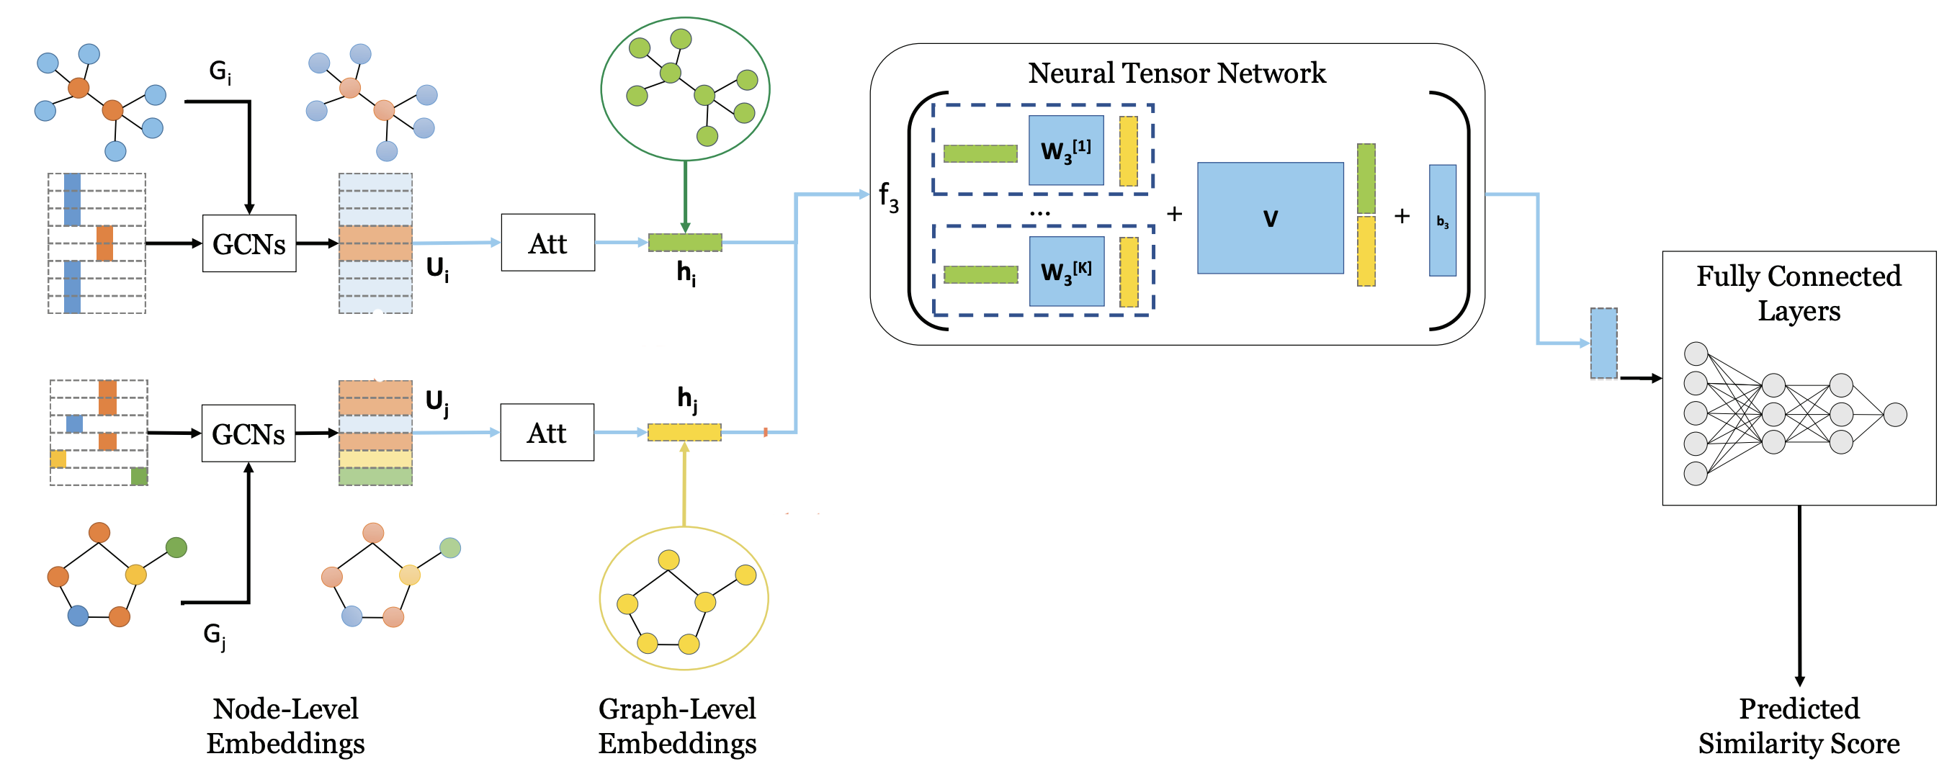
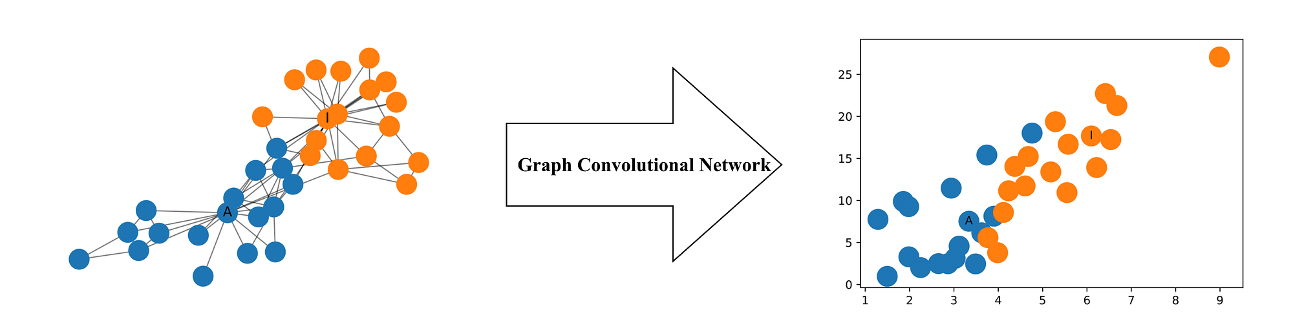
CED Approximation as Function
Munkres algorithm has a polynomial time complexity.
We adopt an approximation model for GED
Graph Convolutional Network (GCN)
representation-invariant
Inductive
Neural Tensor Network
Kipf, Thomas N., and Max Welling. "Semi-supervised classification with graph convolutional networks." arXiv preprint arXiv:1609.02907 (2016).
Y. Bai, H. Ding, S. Bian, T. Chen, Y. Sun, and W. Wang, “Graph edit distance computation via graph neural networks,” arXiv preprint arXiv:1808.05689, 2018
Notes:
GCNs are a very powerful neural network architecture for machine learning on graphs. In fact, they are so powerful that even a randomly initiated 2-layer GCN can produce useful feature representations of nodes in networks. The figure below illustrates a 2-dimensional representation of each node in a network produced by such a GCN. Notice that the relative nearness of nodes in the network is preserved in the 2-dimensional representation even without any training.
representation-invariant, as long as the initialization is carefully designed. It is also inductive, since for any unseen graph, we can always compute the node embedding following the GCN operation
The main advantage is that it can relate the two inputs multiplicatively instead of only implicitly through the nonlinearity as with standard neural networks where the entity vectors are simply concatenated. Intuitively, we can see each slice of the tensor as being responsible for one type of entity pair or instantiation of a relation. For instance, the model could learn that both animals and mechanical entities such as cars can have parts (i.e., (car, has part, x)) from different parts of the semantic word vector space. In our experiments, we show that this results in improved performance. Another way to interpret each tensor slice is that it mediates the relationship between the two entity vectors differently

Slide 44
Assumptions
Number of features are finite
Feature values are mostly categorical
Metadata, topics, and events are features for data, as well as the entities with their own features
Relationships between objects are features which belong to all participating objects
Relation names are different through sources i.e., different text would describe the same action in different forms: wearing, wear, has.
Features such as, clothes-color have different values i.e., UPPER-WEAR-COLOR, SHIRT-COLOR, COLOR all refer to color of clothes.

Slide 45
Generalization
We assume edge labels for level 0 is fixed to hasEntity and metadata with granularity (such as, time, location, etc.). These are flexible and can be set to any labels in FemmIR if it is consistent throughout the lifetime of the system.
Feature-types are assumed to be system-specific and can be variable across different systems and applications. FemmIR can handle any labels for entity-type since the retrieval result does not depend on it.
FemmIR is capable of handling different replacement costs and insertion costs for festures in different application domains.
For the edge replacement cost, any language embedding will work as long as the objective function places semantically similar tokens closer to each other.
Notes:
FemmIR can handle any labels for entity-type since the retrieval result does not depend on it. The comparison between properties are affected by it which remains valid as long as same heuristics is maintained for all modalities in a system.

Slide 46
Evaluation Setup
Ground truth
Ranked data in ascending order of penalties for mismatched features
Penalties for mismatched features:
rcost(top-color) = 1, rcost(bottom-color) = 2, and rcost(gender) = 3
Higher the penalty, higher the importance
For Munkres, API from clapper*
For model architecture,
Hyperparameters: initial node representation, GCN layer #, NTN layer # (K)
We conduct all the experiments on a single machine with Linux Ubuntu 18.04 and one Nvidia Titan GPU.
* https://software.clapper.org/munkres/api/index.html
Notes:
Exact matches are the topmost in the ranking with a zero penalty
One-hot encoding for initial representation of nodes
GCN layer output sizes are 64, 32, and 16
For the NTN layer, we set K to 16.
GCN layers: 3, ReLU as activation function.
The output dimensions for the 1st, 2nd, and 3rd layer of GCN layer output sizes are 64, 32, and 16
. The properties were chosen depending on the user requirement, and the mismatches were assigned different penalties. In Example 4.1, an officer searches in the following order: (1) same gender and race, (2) same bottom clothing, and (3) same top clothing. The intuition behind this is if there is a gender mismatch, they are definitely not the same person. It is possible for a person to change the top clothing in a short span of time, but it is harder to change the bottom clothing. So even if there is a mismatch on top color, there is a chance of it being the same person given similar time-span and vicinity.
We did not use the local node-node interaction information during the training phase for FemmIR.
For the retrieval model, we only considered the synthetically generated part of InciText.
such as retrieving text by video query (Video Text) or, retrieving image by text query (Text Image).
We use 4 fully connected layers to reduce the dimension of the concatenated results from the NTN module, from 32 to 16, 16 to 8, 8 to 4, and 4 to 1.

Slide 47
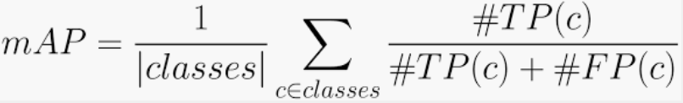

Evaluation Setup
For evaluation,
We consider data samples with CED < 3 in comparison to the query object, as relevant for that query. This would return contents where persons only with color mismatches are found.
Retrieval Task $≡$ Query one modality → Get another or any modality
Notes:
As for training, we set the batch size to 128, use the Adam algorithm for optimization, and fix the initial learning rate to 0.001. We set the number of iterations to 10000, and select the best model based on the lowest validation loss.
Cross-modal retrieval task is retrieving one modality by querying from another modality, such as retrieving text by video query (Video → Text).
Comparison for multi- modality retrieval. By submitting a query example of any media type, the results of all media types will be retrieved such as (Image → All, Text → All).
Mean average precision (mAP) is the evaluation metric, which is calculated on all returned results for a comprehensive evaluation.

Slide 48

Evaluation Setup
Ground truth
Ranked data in ascending order of the penalties for the mismatched properties
Penalties for mismatched properties: rcost(top-color) = 1, rcost(bottom-color) = 2, and rcost(gender) = 3
Higher the penalty, higher the importance
Exact matches are the topmost in the ranking with a zero penalty
For Munkres, we used the API from clapper*
For the model architecture,
GCN layers: 3, ReLU as activation function.
One-hot encoding scheme for initial representation
The output dimensions for the 1st, 2nd, and 3rd layer of GCN are 64, 32, and 16, respectively.
For the NTN layer, we set K to 16.
We conduct all the experiments on a single machine with Linux Ubuntu 18.04 and one Nvidia Titan GPU.
Created based on penalties for mismatch among features
Number of slices (K) $≡$ Number of comparisons of entities or relations
GCN layer #
* https://software.clapper.org/munkres/api/index.html
Notes:
. The properties were chosen depending on the user requirement, and the mismatches were assigned different penalties. In Example 4.1, an officer searches in the following order: (1) same gender and race, (2) same bottom clothing, and (3) same top clothing. The intuition behind this is if there is a gender mismatch, they are definitely not the same person. It is possible for a person to change the top clothing in a short span of time, but it is harder to change the bottom clothing. So even if there is a mismatch on top color, there is a chance of it being the same person given similar time-span and vicinity.
We did not use the local node-node interaction information during the training phase for FemmIR.
For the retrieval model, we only considered the synthetically generated part of InciText.
such as retrieving text by video query (Video Text) or, retrieving image by text query (Text Image).
We use 4 fully connected layers to reduce the dimension of the concatenated results from the NTN module, from 32 to 16, 16 to 8, 8 to 4, and 4 to 1.

Slide 49

Evaluation Setup
As for training, we set the batch size to 128, use the Adam algorithm for optimization, and fix the initial learning rate to 0.001. We set the number of iterations to 10000, and select the best model based on the lowest validation loss.
For evaluation,
Cross-modal retrieval task is retrieving one modality by querying from another modality, such as retrieving text by video query (Video → Text).
Comparison for multi- modality retrieval. By submitting a query example of any media type, the results of all media types will be retrieved such as (Image → All, Text → All).
Mean average precision (mAP) is the evaluation metric, which is calculated on all returned results for a comprehensive evaluation.
We consider data samples with CED < 3 in comparison to the query object, as relevant for that query. This would return contents where persons only with color mismatches are found.
Retrieval Task $≡$ Query one modality → Get another or any modality

Slide 50





Experimental Results and Findings
RQ1,2: How is FemmIR comparable to EARS? Are the performance of our proposed data integration methods comparable to SOTA methods on different MMIR benchmark datasets?
Findings: FemmIR performance is comparable to EARS, even with the current evaluation setup and no modifications on the training method. It could be improved with different values of K and #GCN layers.
Findings: If we have a feature extractor with a good performance, such as the text feature extractor, EARS and FemmIR can perform similarly or better to other retrieval models.
* Solaiman et al., Feature-centric Multimodal Information Retrieval (FemmIR), submitted in SIGMOD 2023
** Hu, Peng, et al. "Scalable deep multimodal learning for cross-modal retrieval." Proceedings of the 42nd international ACM SIGIR conference on research and development in information retrieval. 2019.
Notes:
Synset : a set of synonyms that share a common meaning.
Regular Expressions (key-phrase search)

Slide 51
Experimental Results and Findings
RQ3: Can FemmIR approximate CED closely to an exact method like EARS?
Video → Text
Text → Text
Findings: As the precision-recall curve shows, the results are consistent with our mAP scores. For text modality EARS has near perfect result. For other modalities, FemmIR is performing closely to EARS.
* Solaiman et al., Feature-centric Multimodal Information Retrieval (FemmIR), submitted in SIGMOD 2023
Notes:
Precision-recall curves and precision-scope curves for the image-query-texts and text-query-images experiments on the MS-COCO dataset.
--: The precision-recall and precision-scope evaluations are consistent with the mAP scores for cross-modal retrieval tasks, where our SDML outperforms all the compared methods.

Slide 52
Research Contributions
Novel multi-modal information retrieval approach to retrieve ranked result to information need expressed as Query-by-Example and Query-by-Properties.
Novel edit distance metric, CED, to measure the amount of difference between two data samples based on their semantic features.
Graph coordinated representation learning approach leverages a neural-network based graph-matching technique to capture the interactions between the query example and the streaming data features, with a weak supervision from CED.
Two novel MMIR datasets using MARS, InciText, and PCAM
Prototype and evaluation
Impact: FemmIR can be used for data discovery, data fusion, and Explainable multimodal data retrieval
Notes:
Novel multi-modal joint embedding model which is pre-trained with weak supervision from semantic features. The model can use existing video and image translation models along with existing text feature extractors. WesJem can be applied to any application domain for cross modal retrieval.

Slide 53
Contribution #3: Intrinsic Domain Complexity Estimation
Distributed AI Systems in Open-World Perception Domain

Slide 54


Problem Statement and Motivation
Complexities of well-known games
Intrinsic domain complexity estimation in planning domains
Distributed Learning Environment [1, 2]
Novelty Measurement, Characterization, Adaptation and Detection [Alspector21, Boult22ab, Doctor22, Jafar20, Kim20, Langley20, Peng21, Molineux21]
McMahan, H.B., Moore, E., Ramage, D., Hampson, S., y Arcas, B.A., 2017. Communication-efficient learning of deep networks from decentralized data, in: Proceedings of the 20th International Conference on Artificial Intelligence and Statistics (AISTATS)
Reddi, S., Charles, Z., Zaheer, M., Garrett, Z., Rush, K., Konečn`y, J., Kumar, S., McMahan, H.B., 2020. Adaptive federated optimization.
Notes:
In federated learning [31, 38] multiple entities possess a certain portion of training data and the central server leads the training process by utilizing a model combining method, i.e., FedAvg [31], FedAdaGrad [38], FedYogi [38], etc. However, the existing training mechanisms do not take intrinsic property, i.e., data quality, and data distribution attributes into consideration while training the federated model. Hence the central server does not have any notion of domain complexity while choosing entities during training which hinders the server from determining optimal training algorithm or policy. Since depending on the domain complexity the training mechanism either requires to invest considerable number of iterations (in iterative learning methods) to learn or utilize complex models or converge at lower task accuracy.

Slide 55
Intrinsic Perception Domain Complexity
Dimensionality
1) Environment complexity (EC)
Sparsity
1) Environment representation
2) Principal Component Analysis (PCA)
Heterogeneity
- Diversity in Dataset
- Entropy
- Shannon Entropy
Dataset size * Reduced Dimension Size + # Labels
2) Intrinsic dimensionality (ID)
as much information as possible
as few components as possible
Batty, M., Morphet, R., Masucci, P., Stanilov, K., 2014. Entropy, complexity, and spatial information. Journal of Geographical Systems 16, 363–385. URL: https://doi.org/10.1007/s10109-014-0202-2, doi:10.1007/s10109-014-0202-2.
Tenenbaum, J.B., Silva, V.d., Langford, J.C., 2000. A global geometric framework for nonlinear dimensionality reduction. science 290, 2319–2323.
Wurst, J., Fernández, A.F., Botsch, M., Utschick, W., 2020. An entropy based outlier score and its application to novelty detection for road infrastructure images. CoRR abs/2005.13288
Mairal, J., Bach, F., Ponce, J., 2014. Sparse modeling for image and vision processing.
Notes:
ID: minimal representation of the underlying manifold possible for a dataset [194] without losing any information
ECupper = Ns ∗ Ndr + NC
Number of samples or size of the dataset * Number of features of dimension of dataset
We can further reduce the upper bound by considering the features that have zero vari- ance over the data set. These features have little to no impact on the classifier’s complexity or prediction rate. By variance, we try to see how a particular feature varies over its popula- tion. Features with the same value in all samples are said to have zero variance.
For the perception domain, an environemnet …
remaining components after a representation of some phenomenon with as few variables as possible

Slide 56



Federated Learning Complexity
FL training environment as Tree-based solution
Each path has own complexity
Complexity of Federated Learning tree, $F(d, X)$
$F(d)$ relies on # distinct entities, d
$F\left(X\right)$ relies on # participating entities, n
Intuition
As #participating-entities increases, intrinsic complexity increases, and so the effect on 𝐹(𝑑, 𝑋)
More distinct entities in different servers, more complex
Federated master selects from multiple different paths in the learning tree based on the availability of the entities.
Objective of federated master
Notes:
# If there are more distinct entities in different servers, we have more complexity to train, else less if identitical entities in different servers.
Identitical entity = entity with same class labels
$\left(X\right)$ is proportional and $F(d)$ is inversely proportional to $F\left(d, X\right)$
(not EC, for distributed environment)
M_j is an indicator variable
L2, regulaizrizetiomn term, to ensure the bound
$m_{j}$ is the frequency of the distinct entity j in the federated environment

Slide 57
Assumptions
Each communication round only two entities participate in the training.
Here, by following each single path we achieve a distinct accuracy.
Entity definition do not count individual number of samples or overlapping class labels for simplification
Notes:
In practise, all entities are not available at each communication round for training.

Slide 58
Evaluation Setup
Datasets
MNIST handwritten digit [202], Fashion-MNIST [203] and EMNIST-digits [204]
70K images, with 60K train, 10K test, 28 X 28 pixels
Windows Intel core i7-8th generation with 16 GB of memory
Probenet as Federated Complexity Benchmark (Shallownet)
5 distinct federated clients in the learning environment, where each client contains non-identical local data.
Identical shallow ProbeNet model for each client and the federated server relies on the FedAvg algorithm for each global update.
Effort represents the number of communication rounds in the federated learning context.
Local iteration for each client is 1, and each client contains similar amount of data, allowing us to ignore possible data amount disparity.
For each experiments, we run 100 communication rounds.
F. Scheidegger, R. Istrate, G. Mariani, L. Benini, C. Bekas, and C. Malossi, “Efficient image dataset classification difficulty estimation for predicting deep-learning accuracy,” The Visual Computer, vol. 37, 2021.
Notes:
F. Scheidegger, R. Istrate, G. Mariani, L. Benini, C. Bekas, and C. Malossi, “Ef- ficient image dataset classification difficulty estimation for predicting deep-learning accuracy,” The Visual Computer, vol. 37, 2021.
The accuracy results presented here reflects the accuracy of the federated ProbeNet on the test data.

Slide 59

Experiment Results and Findings
RQ1: Is there a complexity order for the MNIST datasets in terms of the proposed metrices in singular environment?
Findings:
1. Handwritten- MNIST is the least complex and Fashion-MNIST is the most, seen by their variation, and EMNIST-digits is between both.
2. Sparsity at r² = 95% implies that Fashion-MNIST requires a lot of sparse components for explaining variances in between 80% and 95%.
3. At variance threshold = 0, Fashion-MNIST doesn’t include many zeros over the data set, whereas if we consider pixel value 90 as threshold, it still has the largest environment complexity.
* S. Islam and K. Solaiman**, R. Oliveira, B. Bhargava, Domain Complexity Estimation for Distributed AI Systems in Open-World Perception Domain, Artificial Intelligence (Open-World AI), July 2023.
Notes:
Sparsity at r² = 95%, the complexity order changes.
The nuanced increase also indicates that the datasets are all derived from MNIST.

Slide 60



Experiment Results and Findings
RQ2,3: How does Federated Environment Complexity f(d) effects the overall distributed learning complexity?
Five values of d: 1 – 5
Federated Intrinsic Complexity f(x) follows the same pattern for Heterogeneity and Sparsity
Fashion-MNIST
Hand-MNIST
Findings:
For easier handwritten-MNIST, accuracy is higher, and effort is lower than fashion-MNIST.
As the value of f(d) increases, accuracy decreases, in line with the benchmark classifier.
As f(d) increases, the effort increases, while the intrinsic features (at 60% var. thres.) remains identical.
* S. Islam and K. Solaiman**, R. Oliveira, B. Bhargava, Domain Complexity Estimation for Distributed AI Systems in Open-World Perception Domain, Artificial Intelligence (Open-World AI), July 2023.
Notes:
we experiment on five different values of d, ranging from 1 to 5. Figure 7.2b and 7.2c depict the relationship between maximum (or average) accuracy and f(d) for Handwritten-MNIST (the easiest) and Fashion-MNIST (the hardest), respectively.
maximum accuracy is computed here by taking the maximum test accuracy among all the communication rounds, and the average accuracy is the average test accuracy in the communication rounds.
intrinsic features (at 60% var. thres.) i.e., heterogeneity, sparsity, EC and ID

Slide 61

Experiment Results and Findings
RQ4: Is Federated Complexity Metric correlated to Accuracy?
Five values of d: 1 – 5
Findings:
1. Federated complexity is correlated with accuracy with R² value of 0.85.
2. We can see they are negatively correlated, so increase in F(d,X) will decrease the accuracy
3. So, F(d,X) can be considered as a standard metric for evaluating federated learning complexity.
* S. Islam and K. Solaiman**, R. Oliveira, B. Bhargava, Domain Complexity Estimation for Distributed AI Systems in Open-World Perception Domain, Artificial Intelligence (Open-World AI), July 2023.
Notes:
we experiment on five different values of d, ranging from 1 to 5. Figure 7.2b and 7.2c depict the relationship between maximum (or average) accuracy and f(d) for Handwritten-MNIST (the easiest) and Fashion-MNIST (the hardest), respectively.
maximum accuracy is computed here by taking the maximum test accuracy among all the communication rounds, and the average accuracy is the average test accuracy in the communication rounds.
intrinsic features (at 60% var. thres.) i.e., heterogeneity, sparsity, EC and ID

Slide 62
Research Contributions
Novel framework to measure the inherent complexity of the perception domain – with upper and lower limits, including non-linearity
Novel complexity measurement metric for distributed federated environment in perception domain
Extensive experiments on MNIST, Fashion-MNIST, and EMNIST-digits in distinct distributed settings and performed ablation study to measure the impact of each components of our proposed metric on the distributed domain complexity
Notes:
regardless of the specific application, using dimensionality, sparsity, and heterogeneity as components. In this framework, we take into account both upper and lower limits when measuring dimensionality, and we employ both linear and non- linear methods to assess sparsity and heterogeneity.
while combining the intrinsic components and distributed environment features of federated learning.

Slide 63
Contribution #4: Novelties in Multimodal Information Retrieval
Weakly Supervised Joint Embedding for Multimodal Information Retrieval

Slide 64



Problem Statement and Background
How does novelties happen for MMIR?
How does novelties affect multimodal data?
Data Integration with Weak Supervision
Data Shifts
Covariate Shift: Change in application domain with same modalities, or user writes queries differently.
Additional Novelties: Data samples that do not belong to any modality that the framework can handle.
Close to concept drift
Prior Shift: Distribution change of class-label variable, or relevance-label variable, or weak-feature variable (including no weak feature).
Concept Drift: Can be temporal effect or user requirement change over time.
B. Liu, E. Robertson, S. Grigsby, and S. Mazumder, Self-initiated open world learning for autonomous ai agents, 2021.
J. G. Moreno-Torres, T. Raeder, R. Alaiz-Rodríguez, N. V. Chawla, and F. Herrera, “A unifying view on dataset shift in classification,” Pattern Recognition, vol. 45, no. 1, pp. 521–530, 2012, issn: 0031-3203.
https://gsarantitis.wordpress.com/2020/04/16/data-shift-in-machine-learning-what-is-it-and-how-to-detect-it/
Notes:
https://gsarantitis.wordpress.com/2020/04/16/data-shift-in-machine-learning-what-is-it-and-how-to-detect-it/
Covariate Shift: or example deep learning algorithms designed to identify human faces or categorise leaves by tree type. Models may achieve a high degree of accuracy on a labelled training dataset, identifying and categorising the object of an image. However, when deployed with live data changes to input distribution can have a serious impact on model accuracy.
Something as subtle as a change in lighting could shift the distribution of data points, and thereby lower the accuracy of the model. In the case of facial recognition, training data may lack specific ethnicities or ages of subject. When deployed in a live environment, subjects that aren’t in line with training data may have an unrecognisable feature distribution.
Prior probability shift can be thought of as the exact opposite of covariate shift: it is the case that input feature distributions remain the same but the distribution of the target variable changes.
A concept drift happens where the relations between the input and output variables change. So we are not anymore only focusing on X variables or only the Y variable but on the relations between them. Change in posteriror prob. Distribution.
Temporal concept drift with previously relevant data being non-relevant

Slide 65
Weakly Supervised Joint Embedding
Contrastive Learning
Multi-task Learning
Joint Objective Function

Slide 66




Novelty Detection in WesJeM
Data information network is used to detect the changes during post-novelty inference.
Novel Instance.
A test instance $x$ is novel if $G(V_{P_{tr+x}}, E)$ is different from $G\left(V_{P_{tr}} , E\right).$
Considering a knowledge base for the weak features during training ($A_{tr}$), if weak features are absent in $A_{tr}$ during testing, the instance is novel.
($x_{D})$
($x_{v})$
($A_{T})$
Notes:
In the later case, we may see a decline in the model performance.
Post novelty graph is created after translation and weak feature extraction
For novel modality, framework either identifies the new weak features (different from training time) or tackles the new modality as part of the training distribution.

Slide 67

Results for Topics-Topics Objective Function
20 Newsgroups Dataset
Baseline: LSA, LDA
Unimodal: Documents
Measures inter-similarity and intra-similarity between two halves of different documents
Different Negative Sampling Heuristics
We proposed a weakly supervised model with an adaptation compatibility to different types of novelties encountered in Multimodal Information Retrieval without completely re-learning
Notes:
For evaluation, we split each document into two parts, and test if (1) the topics of the first half are similar to topics of the second half (inter-similarity); (2) halves of different documents are mostly dissimilar (intra-similarity). We use cosine similarity to measure the difference between the two vectors of half document topics. For inter-similarity, higher similarity score is better. For intra-similarity, the lower the similarity, the better the vectors are

Slide 68
Future Works
User Preference Modeling
How to model users’ information need in a robust and efficient manner?
user requirement is not always obvious or explicitly stated
user can be interested in multiple types of events and knowledge bases with varying probabilities
Learning algorithms need to adapt to changing user preferences with time
Trust and Privacy
How to avoid bias, increase trust and privacy in recommended results?
How to build data management strategies that leverages multimodal data as a service (MDaaS)?
Notes:
Will be joining UMBC
Open for Tenure-track

Slide 69

Questions?
Knowledge Extraction
Multimodal IR/ Data Integration
Uncertainties
SKOD
SurvQ
Find-Them
FemmIR
WesJeM
$$ID^{2}E$$
𝐼𝐷^2 𝐸
Novelties in MMIR
Accurate data, at the right place, and the right time.

Slide 70
References
S. Poria, E. Cambria, N. Howard, G.-B. Huang, and A. Hussain, “Fusing audio, visual and textual clues for sentiment analysis from multimodal content,” Neurocomputer, vol. 174, no. PA, pp. 50–59, Jan. 2016
Foresti, G.L., Farinosi, M., Vernier, M.: Situational awareness in smart environments: socio-mobile and sensor data fusion for emergency response to disasters. J. Ambient Intelligence and Humanized Computing 6(2), 239–257 (2015).
Meditskos, G., Vrochidis, S., Kompatsiaris, I.: Description logics and rules for multimodal situational awareness in healthcare. In: MMM (1). Lecture Notes in Computer Science, vol. 10132, pp. 714–725. Springer (2017)
Adjali, O., Hina, M.D., Dourlens, S., Ramdane-Cherif, A.: Multimodal fusion, fission and virtual reality simulation for an ambient robotic intelligence. In:ANT/SEIT. Procedia Computer Science, vol. 52, pp. 218–225. Elsevier (2015)
Y. Zhu, J. J. Lim, and L. Fei-Fei, “Knowledge acquisition for visual question answering via iterative querying,” in CVPR, IEEE Computer Society, 2017, pp. 6146–6155.
Q. Wu, P. Wang, C. Shen, A. R. Dick, and A. van den Hengel, “Ask me anything: Free-form visual question answering based on knowledge from external sources,” in 2016 IEEE Conference on Computer Vision and Pattern Recognition, CVPR 2016, Las Vegas, NV, USA, June 27-30, 2016
Kang, D., Bailis, P., Zaharia, M.: Blazeit: Fast exploratory video queries using neural networks. CoRRabs/1805.01046(2018).
M. L. Itria, A. Daidone, and A. Ceccarelli, “A complex event processing approach for crisis-management systems,” CoRR, vol. abs/1404.7551, 2014.
G. Cugola and A. Margara, “Processing flows of information: From data stream to complex event processing,” ACM Comput. Surv., vol. 44, no. 3, 15:1–15:62, 2012.
D. B. Nguyen, A. Abujabal, N. K. Tran, M. Theobald, and G. Weikum, “Query-driven on-the-fly knowledge base construction,” Proc. VLDB Endow., vol. 11, no. 1, pp. 66– 79, Sep. 2017
M. Bienvenu, C. Bourgaux, and F. Goasdoué, “Query-driven repairing of inconsistent dl-lite knowledge bases,” in Proceedings of the Twenty-Fifth International Joint Con- ference on Artificial Intelligence, IJCAI 2016, New York, NY, USA, 9-15 July 2016
X. Dong et al., “Knowledge vault: A web-scale approach to probabilistic knowledge fusion,” in KDD, ACM, 2014, pp. 601–610.
Y. Chen and D. Z. Wang, “Knowledge expansion over probabilistic knowledge bases,” in Proceedings of the 2014 ACM SIGMOD International Conference on Management of Data, ser. SIGMOD ’14, Snowbird, Utah, USA: ACM, 2014, pp. 649–660, isbn: 978-1-4503-2376-5. doi: 10.1145/2588555.2610516. [Online]. Available: http://doi. acm.org/10.1145/2588555.2610516.
M. E. Rodrguez, S. Goldberg, and D. Z. Wang, “Sigmakb: Multiple probabilistic knowledge base fusion,” PVLDB, vol. 9, no. 13, pp. 1577–1580, 2016.
D. Kang, J. Emmons, F. Abuzaid, P. Bailis, and M. Zaharia, “Noscope: Optimizing deep cnn-based queries over video streams at scale,” PVLDB, vol. 10, no. 11, pp. 1586– 1597, 2017. doi: 10.14778/3137628.3137664. [Online]. Available: http://www.vldb. org/pvldb/vol10/p1586-kang.pdf .
M. R. Anderson, M. J. Cafarella, G. Ros, and T. F. Wenisch, “Physical representation- based predicate optimization for a visual analytics database,” CoRR, vol. abs/1806.04226, 2018.
K. Hsieh et al., “Focus: Querying large video datasets with low latency and low cost,” in 13th USENIX Symposium on Operating Systems Design and Implementation, OSDI 2018, Carlsbad, CA, USA, October 8-10, 2018, A. C. Arpaci-Dusseau and G. Voelker, Eds., USENIX Association, 2018, pp. 269–286.
I. Xarchakos and N. Koudas, “SVQ: streaming video queries,” in Proceedings of the 2019 International Conference on Management of Data, SIGMOD Conference 2019, Amsterdam, The Netherlands, June 30 - July 5, 2019,
G. Pearson, M. Gill, S. Antani, L. Neve, and G. Thoma, “People locator: A system for family reunification,” IT Professional, vol. 14, no. 03, pp. 13–21, May 2012, issn: 1941-045X. doi: 10.1109/MITP.2012.25.
R. S. Ferreira, C. G. de Oliveira, and A. A. Lima, “Myosotis: An information system applied to missing people problem,” in Proceedings of the XIV Brazilian Symposium on Information Systems, 2018, pp. 1–7.
[jaist] https://www.jaist.ac.jp/english/laboratory/cci/huynh.html
[triage] https://www.army.mil/article/249169/ai_research_strengthens_certainty_in_battlefield_decision_making

Slide 71
Backup Slides

Slide 72



Can we find a child left in a car? Who needs to know?
Different Context, Useful to Different Users
Different sources, Different Representation
Traffic Cam Snapshot of Silver Sedan
Child left alone on 3rd St in a Silver Sedan
Context:
Earthquake & Rescue Personnel
Context:
Normal Day & Regular Petrol
Mission-relevant info forwarded to Police!
Mission-relevant info forwarded to Rescue Coordinators!
Good
Bad
Notes:
In 2019, 51 children died from heatstroke after being left in a hot vehicle, 2 in Indiana.*

Slide 73
Can we identify malicious intent?
All available Data Sources must be used to Make Decisions
NY Police needs to Know
Context:
New Years Evening
ATF Records
Record of people buying guns and ammunitions in an area
BMV Records
crimemapping.com
GPS tracking
Census Records
Record of DUI Convictions
Is involved in Assault / Disturbing the peace / Homicide / Vandalism
Headed to NYC times square
No Family Connection to NYC or close by
Suspected Person
Utilize all available, relevant information obtained from multiple sources to
autonomously and continually provide decision making information that is specific to application needs, while being able to adapt to uncertainties in a open-world environment
Notes:
All available data sources must be used to make decisions

Slide 74
Challenges
(1) Extracting decision-making information from multimodal data requires finding common representation for source and context, fulfilling current needs from incomplete data, and predicting future needs.
Solution:
Exploiting entity-centric higher-level semantic concepts, RESTful indexing and compute engines integrating RDBMS, distributed stream-processing and queries
Build on top of generic language representation or object detection models, focusing on scalability and exploiting inherent semantic and stylistic properties for task-specific features
Exploiting encapsulation properties, schema mapping, and query translation of RDBMS to gain scalability for data integration
Notes:
functionalities of distributed stream-processing platforms and RDBMS
Task-specific feature extractors in real-world applications requires separate approach from generic language representation or object detection models due to missing or noisy information, lack of annotated data or human resources.
Extracting decision-making information from multimodal data requires learning mission needs, manual analysis of relevant features from heterogenous sources, and predicting future needs. Manual process also suffers from incomplete data and is time consuming.
(2) Task-specific feature extractors requires separate approach from generic language representation or object detection models due to missing or noisy information, lack of annotated data or human resources.
Solution: Build on top of language and object detection models focusing on scalability and exploiting inherent semantic and stylistic properties.
, use schema mapping and query re-writing for translating query-by-example into queries

Slide 75
Challenges
(2) Knowledge management requires data integration and inconsistency resolution. Data integration approaches need to adapt to exact and approximate matches, novel data sources, and continual learning. This often faces the issue of lack of annotation data.
Solution:
Exploiting representation invariance and pervasive characteristics exhibited by graph encoding approaches to compare pre-computed semantic features that model the interconnected structure of datasets and explain similarities.
Exploiting semantic features of data as weak labels to create embedding of different modalities of data and their features in the same space
Using Semantic Features
Learning Models
Weak Labels
Notes:
(Attention network).

Slide 76
Challenges
(3) Decision making models with multimodal data assumes closed-world fixed models and accumulates no knowledge.
Solution: Characterize, detect, and adapt to novelties in dynamic data-driven applications and agent-based systems, such as in planning domains.
(4) Multimodal information retrieval, collaborative learning, or feature extraction models need to be run with different architectures and datasets to understand what is the best possible solution for any application.
Solution: Identify Intrinsic Domain Complexity of any dataset irrespective of learning models
Notes:
Collaborative learning == federated learning

Slide 77

Situational Knowledge on Demand
The project is applicable across a variety of industries, military to commercial to academic.
Principal Investigators:
Bharat Bhargava, Purdue University Research
Extract and identify patterns related to significant mission needs
Develop algorithms to establish situational awareness
Connect disaggregate knowledge sources
Responsible AI
Michael Stonebraker, Massachusetts Institute of Technology Research
Information Value Recommendation
Push relevant information efficiently to interested parties (e.g. analysts, experts, and decision makers) , Data Cleaning, integration
Aarti Singh, Carnegie Mellon University Research
Context Aware Machine Learning
Metadata Tagging
Matei Zaharia, Stanford University Research
Systems for emerging large-scale workloads
Infrastructure for usable machine learning

Slide 78
Technical Details and Approach
Streaming Data inserts into Postgres
Extract relevant features from heterogeneous data using type dedicated Content Knowledge Extraction Modules
Construct Multi-Modal Knowledge Graphs from Source Contents and Query Examples
Find Relevance after Context Matching and Similarity Computation
Build heterogenous information network from relevant data
Build User Preference Model from schema and query history
Push relevant content to the user via WebSockets and Triggers
Integrate scalable compute engines to analyze graph-structured data at scale

Slide 79
Data Streaming Module
Retrieve RESTFUL and Streaming Tweets
Retrieve Streaming Videos and Images
Populate Postgres with Incoming Data
Parse collected metadata to extract targeted information and store in Postgres
Replicable, Fault tolerant, Scalable and Continuous
Build a Data Processing Pipeline accommodating any type of Modality

Slide 80
Compatibility with New Sources
Add new sources i.e.,
JDBC
From file
Audio
Kafka Connect provides a framework (extra layer between source and Kafka) to develop connectors importing data from various sources and exporting it to multiple targets
Kafka Clients allow us to pass and retrieve messages directly to and from Kafka

Slide 81


Incomplete Data Delivery Over Time
User Query
Notification for Newly Streamed Relevant Data
Incomplete Results
From Single Modality
Streaming Data
Trigger Functions
Notes:
Query results over time
Delivery-on-demand and from available data

Slide 82

Multimodal Query Engine
High-level Semantic Feature for Data Representation
Interpretability
Explainable by interrogation
Explainable by design
Scalability
Compatibility with SOTA models
Context Representation
User uploads example or semantic features
Query-by-example or Query-by-feature
Feature Extraction (Assumption is available)
Domain Independent
Task Specific
Knowledge Modeling
knowledge $≡$relational data and SQL queries on the data
persist for lifetime of knowledge base and grow with additional user interests
Notes:
1. Semantic features if chosen as medium to represent data for further data fusion and relevance learning, gives user interpretabilkity and the similarity results can be explained by ..
This also allows us to uyse eisting SOTA object detection or language models if the mission only needs already identified features
Using Features allows us to not train large pre-trained similarity models and makes data relevance scalable
2. User can upload context with example or features
3. We need to define domain-agnostic feature extraction technique for most use cases – next slide
$ Knowledge Modeling – knowledge is represented with relational data and SQL queries on the data, persist for lifetime of knowledge base and grow with additional user interests

Slide 83

Knowledge Modeling through Multiple Modalities Data Integration
Challenges
Different Schema / Feature-name in different modalities
Entity-Attribute-Relationship model with SQL Queries (EARS)
View based Data Integration
Mediators and Global Schema
Global-as-View (GAV) approach
Translate query features into conjunction of features
SQL-Join
integrate multiple modalities and multiple types of information
Scalable and fast
Text
Video
Notes:
SurvQ or Urban info. Knowledge base /
Data Integration
Generalizable
Uses Features
Learnable
We implement a nested loop join on relations from each modality and the incident relation. Each queried missing person incident are converted into relation R with features F1, F2, . . . , Fm. Features from modalities are translated into relations T1, T2, . . . Tn, where n is the number of modalities in the system. We perform a join between R and each Tk (k ≤ n) using the join predicate JP on all queried features,
For example, in Figure 3.2, features from the video feed are translated into relation T1, and features extracted from the incident report are translated into relation T2 after schema mapping. If the user is interested in a person with features F2, F6, . . . , Fi, we create a JOIN query over all the translated relations and the incident relation on features F2, F6, . . . , Fi.

Slide 84












Knowledge Discovery: EARS-JOIN
①
Capture Streaming Data;
Pre-processing; Convert to MP4, txt; Store in Postgres
(Data Capture and Data Storage)
②
Run ML and heuristic models on
video, text and tweets
(Feature Identification)
③
Create Query from User Requirement with DDL and return JOIN results w/ Predicate Matching
(Data Fusion)
④
Return relevant results to user’s examples
(Data Retrieval)
Notes:
Data Ingestion supports scalability and real-time analysis
Different feature identification techniques for different contexts
Fusion with RDBMS and relational queries allows scalability and automated investigation with Situational Awareness
Complete query results over time
Easy-to-use Interface for everyone
Data Models and Information Association
Constructing entity-attribute-relationship (EAR) model of the application domain
mapping this to a relational data base with schema S
streaming data is captured and loaded into the database
new data sources require extending the EAR and the schema.
User Queries
Either standing queries or one-shot queries
One shot queries are translated into SQL for S and executed immediately
Other Similarity Comparisons are approximate queries, and can be made with appropriate predicates
Rest is feature extraction to be done at load time

Slide 85
Data Fusion and Relevance Matching with EARS
Streaming Input or Data-at-rest
Schema Mapping
T₁
T₂
S
Pattern Matching with Predicates
User Input
F₂ , F₆ , F_{i}
F₂ , F₆ , F_{i}
T₁ ⨝ T_{2 ……} ⨝ T_{k}
Exact or Approximate Results
Global
Schema
Content Relevance Discovery
F₂ , F₆ , F_{i}
Extracted Features
Features are extracted from raw input
Notes:
We create a global schema from user input/ incident
Map the features to global schema

Slide 86
Knowledge Modeling through Multiple Modalities Data Integration
Challenges
Different Schema / Feature-name in different modalities
Entity-Attribute-Relationship model with SQL Queries (EARS)
View based Data Integration
Mediators and Global Schema
Global-as-View (GAV) approach
Translate query features into conjunction of features
SQL-Join
integrate multiple modalities and multiple types of information
Scalable and fast
Text
Video
Notes:
SurvQ or Urban info. Knowledge base /
Data Integration
Generalizable
Uses Features
Learnable
We implement a nested loop join on relations from each modality and the incident relation. Each queried missing person incident are converted into relation R with features F1, F2, . . . , Fm. Features from modalities are translated into relations T1, T2, . . . Tn, where n is the number of modalities in the system. We perform a join between R and each Tk (k ≤ n) using the join predicate JP on all queried features,
For example, in Figure 3.2, features from the video feed are translated into relation T1, and features extracted from the incident report are translated into relation T2 after schema mapping. If the user is interested in a person with features F2, F6, . . . , Fi, we create a JOIN query over all the translated relations and the incident relation on features F2, F6, . . . , Fi.

Slide 87
Text Feature Extraction
Language Models
Named Entity Recognition
Challenges
Large Unstructured Text
Lack of Annotations
Domain Specific Mission Needs
Task Specific
Use Syntactic Properties

Slide 88
Experimental Results and Findings
RQ4: Which one is the best method for video attributes in Person Querying System?
Resnet50 needed 513 minutes and temporal attention model needed 1073 minutes for training
* MARS (Motion Analysis and Re-identification Set)
s
s
s
Findings:
If only static features are of interest i.e., gender, CNN-based object detectors are enough.
If static and dynamic features (have effects from time and space) are of interest, CNN with temporal attention works better.
Findings:
On average, CNN with temporal attention is a better method for human attribute detection from videos.
Findings:
Color Sampling can be a good solution for cold start problem, but compared to neural network models the performance is weak.
* K. Solaiman, T. Sun, A. Nesen, B. Bhargava and M. Stonebraker, "Applying Machine Learning and Data Fusion to the Missing Person Problem" in IEEE Computer, vol. 55, no. 06, pp. 40-55, 2022.
Notes:
Color Sampling can be a good solution for cold start problem, but compared to neural network models the performance is weak.
On average, CNN with temporal attention is a better method for human attribute detection from videos.
We follow the original train/test partition of MARS dataset for benchmarking. For models in [114–116], we formed a training batch by randomly selecting 32 tracklets, and then by randomly sampling 6 frames from each tracklet. During testing, F frames of each tracklet are randomly split into ⌊ Fn ⌋ groups, and the final result is the average prediction result among these groups. We used a validation set of mutually exclusive 125 people selected from the training set. For color sampling, we used the result from the first frame from each tracklet. We compared three properties across all models - gender, top color and bottom color.

Slide 89


Property Identification from Unstructured Text.
Suspect was a white male, wearing buttoned-up shirt and blue jeans.
Notes:
Similarity between word meanings refers to a relative distance between these word meanings in the hypernym tree
Nli and SBERT

Slide 90

Video Feature Extraction Evaluation
Metrics used:
Trained YOLO v3 and YOLO v4 on the 9400+ and 12200+ datasets with 6 classes to detect gender, clothes and color
YOLO v4 with the largest dataset performed best
For performance evaluation of YOLO for new classes in Surveillance Videos, we used mean average precision (mAP) as performance metric.
The graph shows the mAP values for gender and clothes classes.
For gender, we obtained mAP score of 68
For colored clothes, we obtained mAP score of 58
For performance evaluation of color sampling method, we used precision, recall, and F1-score as performance metric.
We used fashion images as dataset having clothes with 8 colors
Each class has 50 people
On Avg, color sampling method obtained 95% F1-score
Mean Average Precision
8 color classes. Each class with 50 people
precision and recall stats was calculated as 1 color vs other 7 colors

Slide 91
Demo Details
Step 1: create a missing person incident or upload an example with user input
Step 2: create predicates – features to search for
Step 3: perform schema mapping from features to global schema
Step 4+5: Perform SQL JOIN among different data sources
Combine the results
Step 6 (different viewpoints): there are three possible viewpoints the user can choose from to see the results: list, map, and timeline.
List shows the matching incidents in order
Map shows the places where the incidents were found
Timeline shows time progression on the results

Slide 92












④ⓐ
①ⓐ
doc_record
id
filename
incident_date
incident_location
Upload Page
Creation Page
location_record
latitude
longitude
location
address
device_id
document_id
people_report
Hat_color
Hair_color
Shirts_color
Pants_color
Jacket_color
Gender
①ⓑ
video_record
id
device_id
link
time
④ⓑ
③
②
List Viewpoint
⑤
Timeline Viewpoint
Investigation Page
⑥
Map Viewpoint

Slide 93
User Modeling: Intention-aware Recommendation Engine
Sends users streaming data that corresponds to their interests
Builds User Profiles using the history of user queries
Active Learning to narrow/expand intention model with more interaction
Expands user queries with word embedding models to fetch relevant data from the database
Analyze user queries for user profiling
Expand result of queries with word2vec
Active Learning to improve intention model with time
User1
Cars of specific make & model (purple Cadillac)
Interested in info. about crimes in a specific district
SELECT * FROM video_data WHERE object = ‘car’ and attribute=‘purple’
User2
SELECT * FROM crash_data WHERE
date_hit = TODAY
Looks for pedestrians in the video data
Interested in traffic, accidents, violations

Slide 94
User Preference Modeling in Relational Databases (UPref)
Unsupervised model
For modeling preference of same user -
Group tables tied by foreign key constraints
Group tables with semantically similar name
Group columns in same table by their relations
Group semantically similar column values
From historical queries
Deliver the columns and tables in the same group the current query belong to
Each user has its own preference model based on the query history
Upon Feedback about the delivered relevant data
Narrow/Expand the current users’ preference model

Slide 95
Disaster Time Rescue and Response
Locate Missing Person for
Person Re-location during Disaster
Amber Alerts
Aged Person Identification
Missing Kids
Drone Surveillance for Search and Rescue in Disasters
Resource Distribution during Disasters

Slide 96
EXAMPLE APPLICATION DOMAIN: POLICE INVESTIGATION SYSTEM Similar System in Practice
https://www.fbi.gov/services/cjis/ndex
Unclassified national information sharing system that enables criminal justice agencies to search, link, analyze, and share local, state, tribal, and federal records.
Strategic investigative information sharing system that fills informational gaps and provides situational awareness.
Analysts: Connecting the Dots
Detectives: Linking Investigations
Patrol Officers: Preparing for Encounters
Regional Dispatchers: Increasing Officer Safety
incident, arrest, and booking reports; pretrial investigations; supervised released reports; calls for service; photos; and field contact/identification records.

Slide 97
Hierarchical Attributed Relational Graph (HARG)
Notes:
Hierarchical Attributed Relational Graph
Entity-with-Property-in-Leaf Vertices

Slide 98
Relevance Learning with Graph Matching
Streaming Input or Data-at-rest
Extracted Features
F₂ , F₆ , F_{i}
User Input
 | 0.95
 | 0.70
 | 0.63
Deliver Content with Ranking
0.95
0.0
0.70
0.63
0.40
Filtering
Graph Matching and CED Approximation
Features are extracted from raw input
Notes:
We create a global schema from user input/ incident
Map the features to global schema

Slide 99
SimGNN for Graph Similarity Computation
Notes:
Weighted sum

Slide 100




Federated Learning Complexity
Notes:
(not EC, for distributed environment)
M_j is an indicator variable
L2, regulaizrizetiomn term, to ensure the bound
$m_{j}$ is the frequency of the distinct entity j in the federated environment

Slide 101

Results for $ID^{2}E$

Slide 102


Results for $ID^{2}E$ – Sparsity as f(X)
Heterogeneity follows the same pattern

Slide 103


Multi-task learning
For each object, $o_{i}$in the graph participating in relation $R$, $s_{i}^{p}$ and $s_{i}^{n}$refers to positive and negative examples. $e_{o_{i}}$refers to the vector embedding of the graph object $o_{i}$ , and $y$ is the label.
$y = 1$for ($o_{i}$ , $s_{i}^{p}$ ) pairs and $y = 0$for ($o_{i}$ , $s_{i}^{n}$ )
Notes:
. In the embedding space, the relations originally defined over the vertices in the information graph are expressed as a similarity score between the vectors representing these vertices. The relationships between the features themselves are also expressed as a similarity score between the vectors representing them. To force these relationship constraints on the data samples, we consider this as a multi-task learning problem, over all the relations in the graph.
For example, if a document and a video, or two documents have same topic, they should have similar embedding. In parallel, if the two data samples are discussing about the same event, they should have similar embedding. Our embedding function should jointly reflect these similarities
The objective of the model is to maximize the similarity with a positive example and minimize the similarity with a negative example.

Slide 104


Learning objectives
Features to Features $(A_{T}A_{T} /A_{n}A_{n}/A_{event}A_{event})$
Similar topics, named entities, or events with embedding value within a certain threshold, are placed together
Data Sample to Data Sample $(x_{D}x_{V} /x_{D}x_{D}/x_{V}x_{V})$
Positive pairs are selected by
Topics, Events and Entities, User Provided similarity labels, and Embedding
Data Samples to Features $(xA_{T} /xA_{event}/xA_{n})$
Joint Object Function, where $O$ is defined over all the objectives, weight $λ_{i}$ is set to 1.

Slide 105




Reasoning Over the Data Information Network
Weak Supervised Baseline
With the data information graph
#paths from one data sample to a given data sample or a given feature
counting the paths from one data sample to a given data sample or a given feature.
Similarity Based Score.
Given a data sample, or a feature a and their embedding $e_{a}$ the relevance score with other data sample b with embedding $e_{b}$ is:

Slide 106
Novelty Characterization
Covariate shift with change in application domain with the modalities for which translation module is available (covar-1).
Prior probability shift with novel weak features (prior-1).
Prior probability shift with no weak features (prior-2).
Prior probability shift with novel relevance label (prior-3).
Temporal concept drift with previously relevant data being non-relevant (concept-1).
Covariate shift with new modality introduction (covar-2).

Slide 107
Novelty response
pre-trained retrieval model from WeS-Jem
three level training strategy
With new modality introduction novelty, both image and LIDAR modality can be handled with the video translation module. Initial text embedding approaches can generate text embedding for any textual input for prior data shift.
Linear embedding layers in WeS-JEm maps the OOD inputs into the pre-trained joint embedding space
For (prior-2) novelty, when system relearns, only the (xx-embedding) objective functions remains active
For novel modality introduction, a new translation method can be learned.
User similarity labels provided by Relevance Feedback module have greater weights than old ones
Notes:
The final similarity score between data samples in the embedding space would produce the relevance between new samples.

Slide 108
Experimental Results over Topics-Topics Objective
20 Newsgroups Dataset
Baseline: LSA, LDA
Unimodal: Documents
Measures inter-similarity and intra-similarity between two halves of different documents
Different Negative Sampling tests
Notes:
For evaluation, we split each document into two parts, and test if (1) the topics of the first half are similar to topics of the second half (inter-similarity); (2) halves of different documents are mostly dissimilar (intra-similarity). We use cosine similarity to measure the difference between the two vectors of half document topics. For inter-similarity, higher similarity score is better. For intra-similarity, the lower the similarity, the better the vectors are

Slide 109
Contributions
Scalable, real-time, feature-centric Situational Knowledge extraction and dissemination framework with a multi-modal relational knowledge base that can fulfill current and future data needs from incomplete and disaggregate data sources
A novel text attribute detection model using language representation models and syntactic properties
A Video Querying System with human-in-the-loop, Find-Them, and two novel MMIR datasets
A View-based Data Integration using relational structure of RDBMS and SQL Queries
Flexible, scalable, representation-invariant learning models for data integration, relevance-ranking, and similarity matching
Coordinated representation learning with graph matching and a novel distance metric for data objects
Relevance learning using weak supervision
Novelty Characterization, Detection, and Adaption in Multimodal Information Retrieval, distributed AI systems, and in planning domains
A novel intrinsic complexity metric for distributed AI applications in perception domains
Notes:
EARS: delivers integrated query results over time using a mediator approach along with Postgres triggers, with semantic mapping and query-by-example. User pref. modeling is done by creating knowledge base with queries.
representation learning
and similar area detection
Without labeled data for

